Slide 1

Three-dimensional non-linear vortex structures in the Blasius boundary layer flow
H. Wedin, G. Zampogna & A. Bottaro
DICCA, University of Genova, Italy
… including a contribution by
Hanifi
FOI and Linné Flow Center Stockholm, Sweden

Slide 2
Why are nonlinear unstable recurrent solutions important?

Slide 3
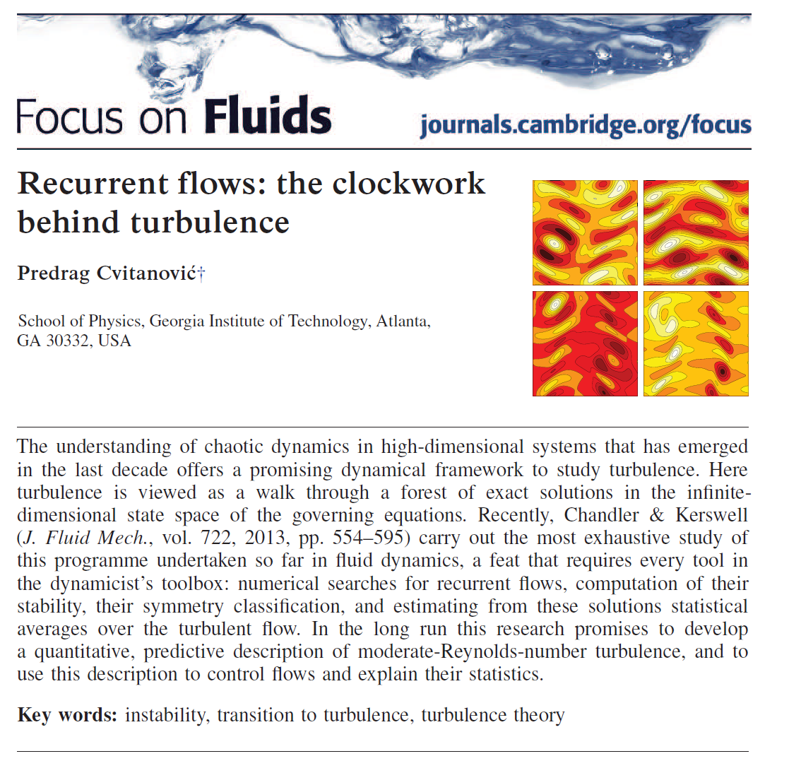
1

Slide 4
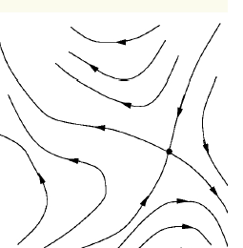
2
Separatrix, edge …
“Chaotic
attractor”
Laminar fixed point
Typically, plots in the (power,dissipation) space are used. Projecting onto such global quantities is “a bit like hoping to land ‘Curiosity’ on another planet by tracking the sum of the kinetic energies of all planets versus the sum of their angular momenta squared” (Cvinatović 2013)

Slide 5
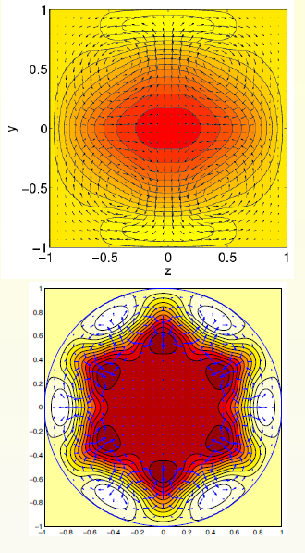
“Old” TWS:
Uhlmann, Wedin etc.
Kerswell, Ekhardt, etc.

Slide 6
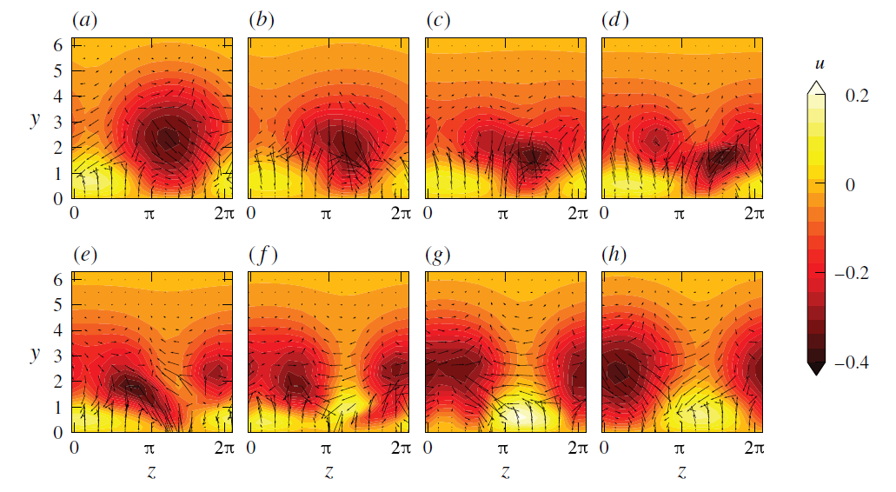
Asymptotic suction boundary layer,
Kreilos et al. (2013)

Slide 7
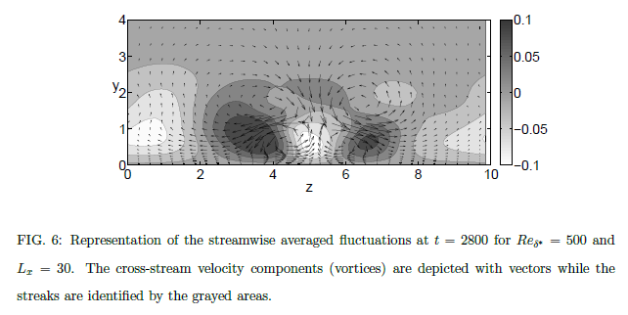
Including non-parallel effects:
Biau (2012); sinuous streaks
Duguet et al. (2012); varicose/hairpin
Cherubini et al. (2011); two solutions on the edge …

Slide 8
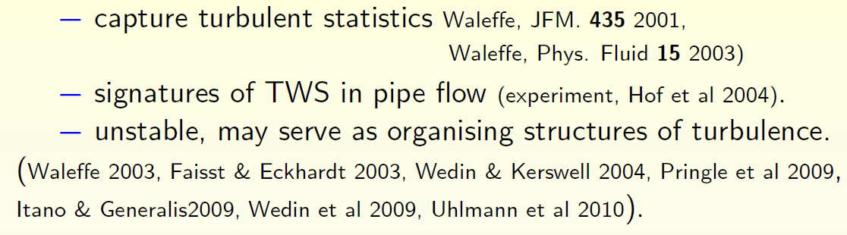
Here: the “parallel” Blasius boundary layer is studied to identify TWS. Of interest since: and non-parallel effects are likely small at Re sufficiently large

Slide 9
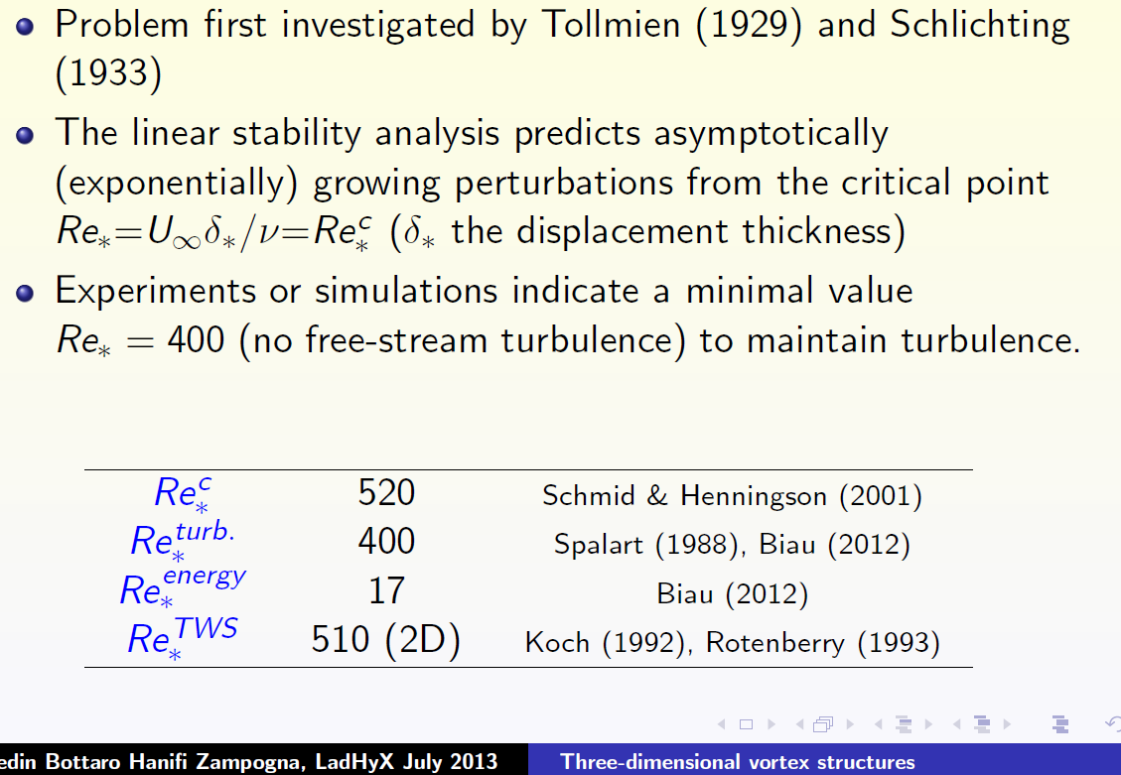
Facts:

Slide 10

Dhawan, 1953

Slide 11


Add a forcing term to x-momentum equation to ensure a parallel flow. Then: and solve for K_{p} to satisfy the asymptotic condition at y∞ (Milinazzo & Saffman 1985, Rotenberry 1993).
K_{p} = 1 when the disturbance is infinitesimal.

Slide 12
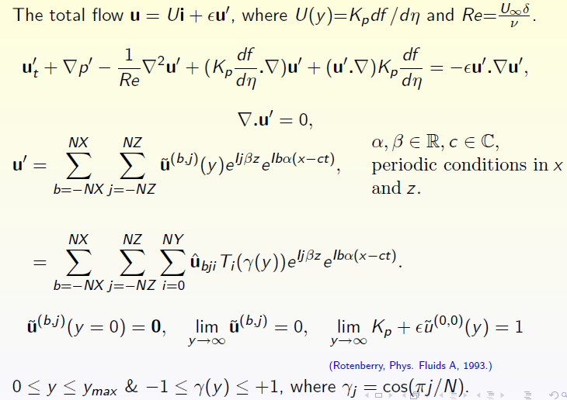

Slide 13
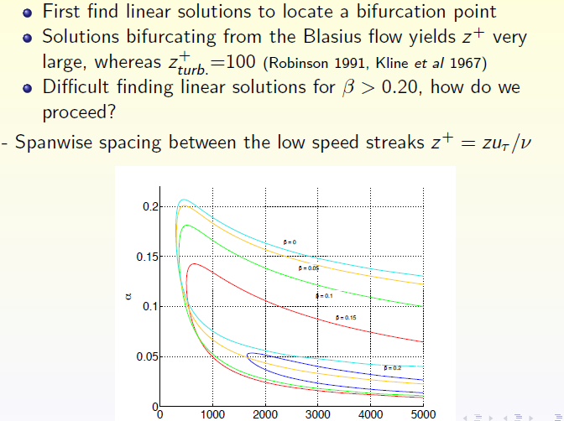
Re

Slide 14
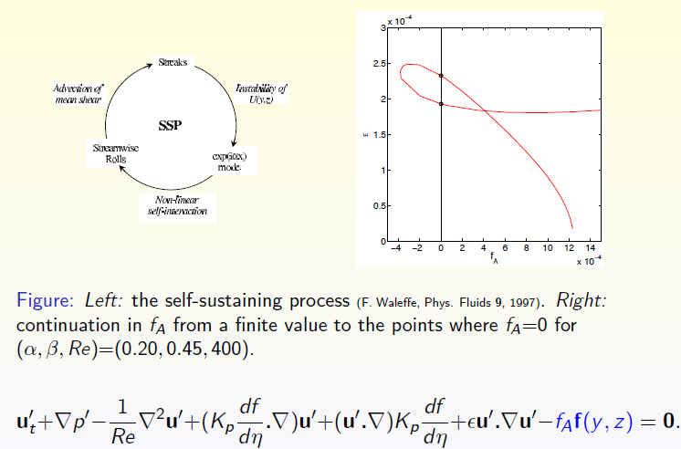
Start from the “self-sustaining process”

Slide 15
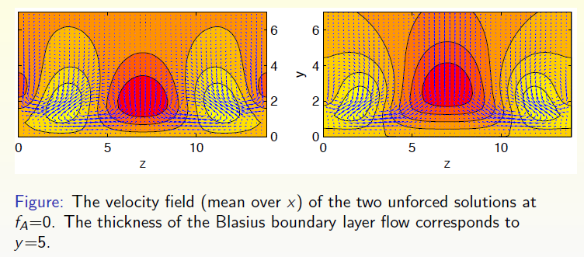

Slide 16
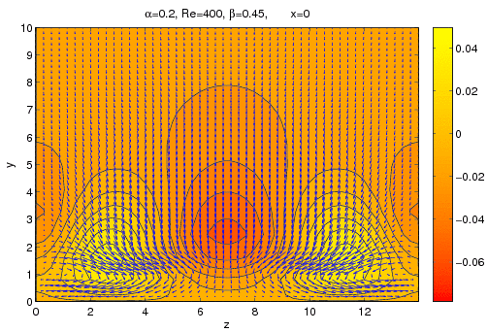

Slide 17
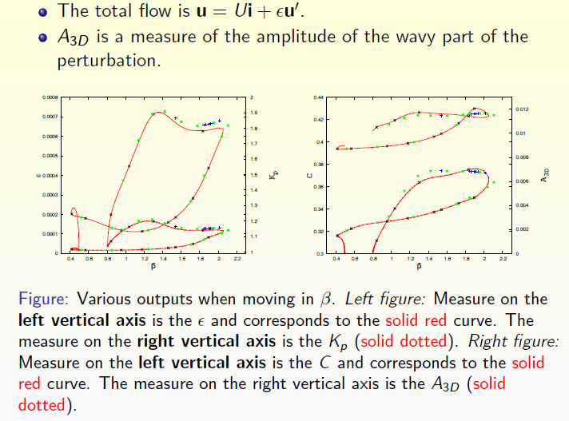

Slide 18
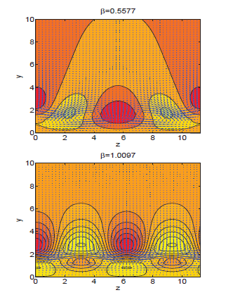
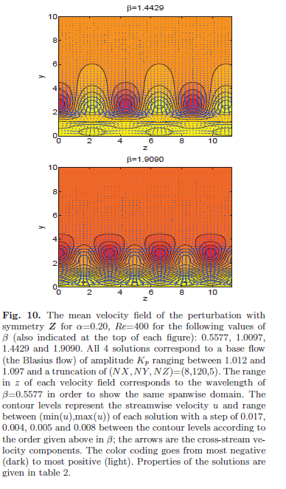

Slide 19
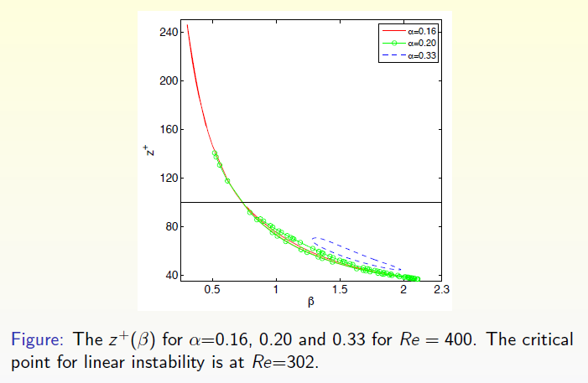

Slide 20
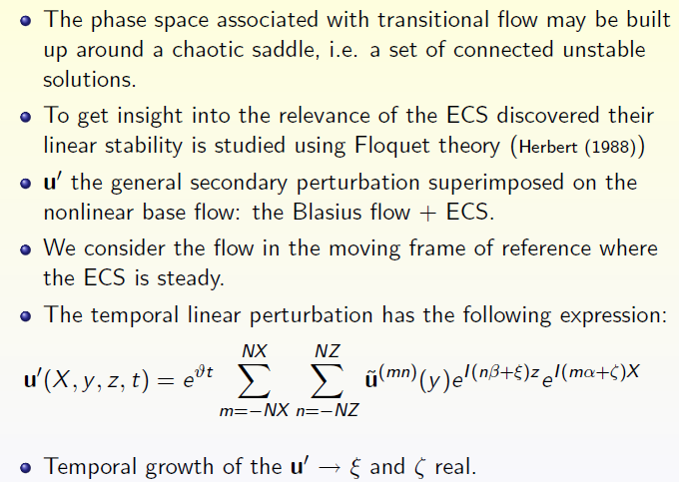
Stability of the solutions found

Slide 21
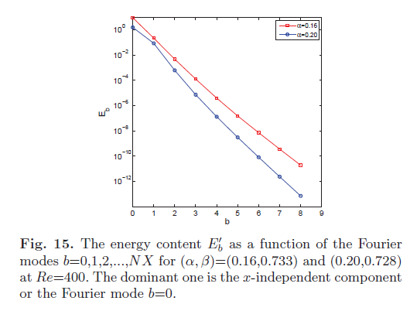
To simplify analysis,
base flow is the mean over X

Slide 22
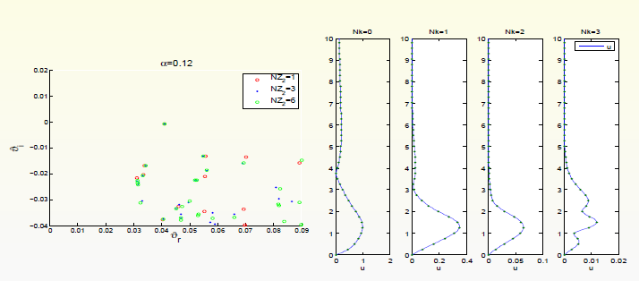
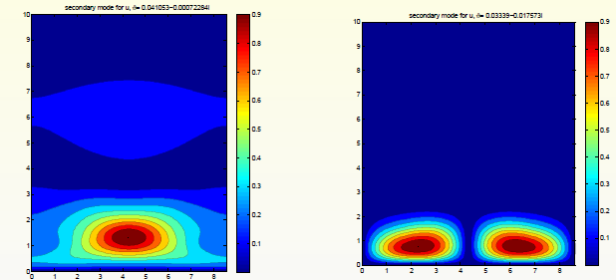
Secondary modes
at Re = 400,
β = 0.728 (z⁺=100)

Slide 23
1. Blasius boundary layer rendered artificially parallel via a body force
2. TWs found (mainly by application of SSP process), similar to the edge state solutions found by Biau (2012)
3. Solutions found are unstable
4. Still a long way from Hopf (1948) goal of a “rational theory of statistical hydrodynamics where […] properties of turbulent flows can be mathematically deduced from the fundamental equations of hydromechanics”
CONCLUSIONS

