Slide 1


FLOW OVER ROUGH SURFACES
Alessandro Bottaro
Santorini – June 18-22, 2018

Slide 2
STUDY OF THE FLOW OVER POROUS AND/ OR ELASTIC WALLS IS ONGOING, BY THE SAME ADJOINT HOMOGENIZATION APPROACH
With many thanks to:
Edoardo Alinovi, Giuseppe Zampogna, Sahrish Naqvi and many others!

Slide 3
‘‘Life’’ is not smooth, but anisotropic, multiscale, heterogeneous, rough, porous, flexible, etc.
CFD & Optimization
Alessandro Bottaro
DICCA, University of Genova

Slide 4
‘‘Life’’ is not smooth, but anisotropic, multiscale, heterogeneous, rough, porous, flexible, etc.
CFD & Optimization
Alessandro Bottaro
DICCA, University of Genova

Slide 5

CFD & Optimization
Alessandro Bottaro
DICCA, University of Genova

Slide 6
CFD & Optimization
Alessandro Bottaro
DICCA, University of Genova

Slide 7
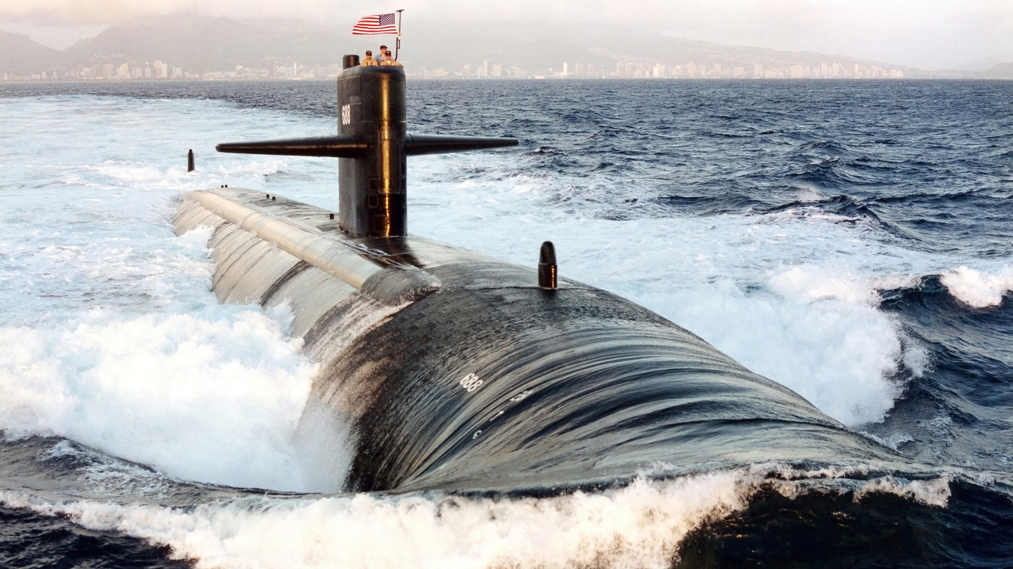

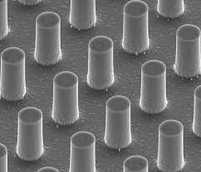

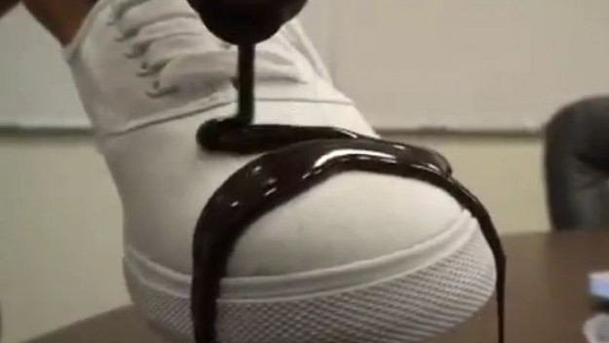
marine and underwater microfluidics
CFD & Optimization
Alessandro Bottaro
DICCA, University of Genova
anti-icing self-cleaning

Slide 8
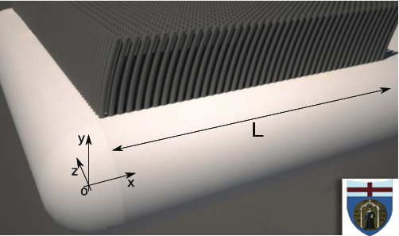
Sometimes a detailed microscopic description of the flow around such multiscale surfaces is impossible …
GOALS:
to model apparent slip over realistic surfaces, interfaces and layers (poro-elastic and poro-plastic) using the theory of homogenisation to average out the fine details around the surface/interface/layer, and
extend the macroscopic ‘‘Navier’s
slip condition’’ …
CFD & Optimization
Alessandro Bottaro
DICCA, University of Genova

Slide 9
A BIT OF HISTORY
CFD & Optimization
Alessandro Bottaro
DICCA, University of Genova
λ
U(0) = U_{s}

Slide 10
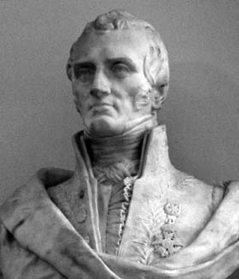
Claude Louis Marie Henri Navier (1785-1836)
CFD & Optimization
Alessandro Bottaro
DICCA, University of Genova

Slide 11
Claude-Louis Navier
CFD & Optimization
Alessandro Bottaro
DICCA, University of Genova

Slide 12

Claude-Louis Navier
CFD & Optimization
Alessandro Bottaro
DICCA, University of Genova
Sir George Gabriel Stokes
(1819-1903)

Slide 13
…..
….….

Slide 14
(″elle″ = the wall)
CFD & Optimization
Alessandro Bottaro
DICCA, University of Genova

Slide 15
In today’s terminology, Navier’s argument was that (i) there is partial slip, with
(ii) the resistance of the wall proportional to the slip velocity U_{s}:
E U_{s} = -ε dU/dy|_{y=0} → U(0) = (-ε/E) dU/dy|_{y=0} = λ dU/dy|_{y=0}
λ = slip length
CFD & Optimization
Alessandro Bottaro
DICCA, University of Genova
λ

Slide 16

Navier’s slip condition is a first-order development around a fictitious wall (the position y = 0 is arbitrary) applicable when either
(i) the surface geometry is microstructured or
(ii) the continuum approximation breaks down.
There is a unique slip length λ for U and W only in the case of isotropic (in x, z ) walls. The general (anisotropic) case requires (to first order) that:
$\left[\begin{matrix}U(x,0,z) \\ W(x,0,z)\end{matrix}\right]$ = ☹ $\frac{∂}{∂y}\left[\begin{matrix}U(x,y,z) \\ W(x,y,z)\end{matrix}\right]$_{y=0}
with L a slip tensor (plus a non-penetration condition for $V$).
CFD & Optimization
Alessandro Bottaro
DICCA, University of Genova

Slide 17

In the 18th century Daniel Bernoulli,
Du Buat and Coulomb had already
argued for partial slip or no-slip …
Later on, the situation became
somewhat confusing …
CFD & Optimization
Alessandro Bottaro
DICCA, University of Genova

Slide 18
Navier’s equations have later been re-discovered and/or extended to the compressible case by:
1828: Augustin-Louis Cauchy (1789 - 1857)
Exercises de Mathématiques, p. 187
1829: Siméon-Denis Poisson (1781 – 1840)
Journal de l’Ecole Polytechnique, XXe cahier, p. 152, 1831
1843: Adhémar Jean Claude Barré de Saint Venant (1797 -1886) Comptes Rendus de l’Academie des Sciences, v. 17, p.1243
1845: George Gabriel Stokes (1819-1903) Transactions of the Cambridge Philosophical Society, Vol VIII, 1849, p. 287
CFD & Optimization
Alessandro Bottaro
DICCA, University of Genova

Slide 19

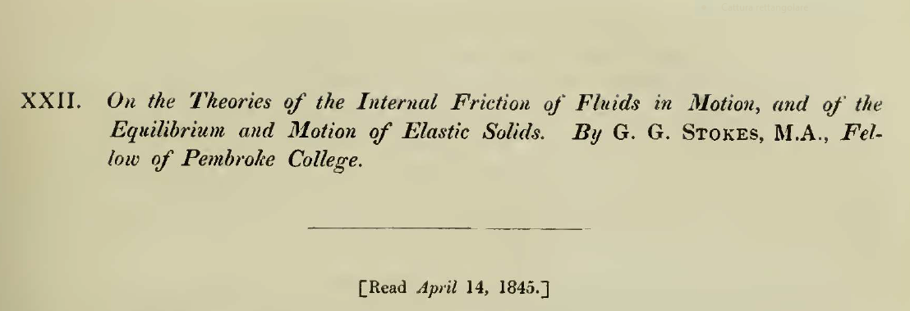
CFD & Optimization
Alessandro Bottaro
DICCA, University of Genova

Slide 20
CFD & Optimization
Alessandro Bottaro
DICCA, University of Genova

Slide 21
CFD & Optimization
Alessandro Bottaro
DICCA, University of Genova
NO SLIP?
τ_{w}  U_{s}²
(because of
surface
irregularities?)

Slide 22
CFD & Optimization
Alessandro Bottaro
DICCA, University of Genova
…
s
s

Slide 23
Later on …
1850: Stokes U_{s} = 0 ‘‘highly satisfactory’’
1879: Lamb U_{s} ≠ 0 on account of experiments by Helmholtz & Piotrowski (1860)
1890: Whetham U_{s} = 0 through accurate experiments
1895: Lamb U_{s} = 0 ‘‘... in all ordinary cases …’’
1922: Taylor U_{s} = 0!
CFD & Optimization
Alessandro Bottaro
DICCA, University of Genova

Slide 24
Later on …
1850: Stokes U_{s} = 0 ‘‘highly satisfactory’’
1879: Lamb U_{s} ≠ 0 on account of experiments by Helmholtz & Piotrowski (1860)
1890: Whetham U_{s} = 0 through accurate experiments
1895: Lamb U_{s} = 0 ‘‘... in all ordinary cases …’’
1922: Taylor U_{s} = 0! CASE CLOSED?
CFD & Optimization
Alessandro Bottaro
DICCA, University of Genova

Slide 25
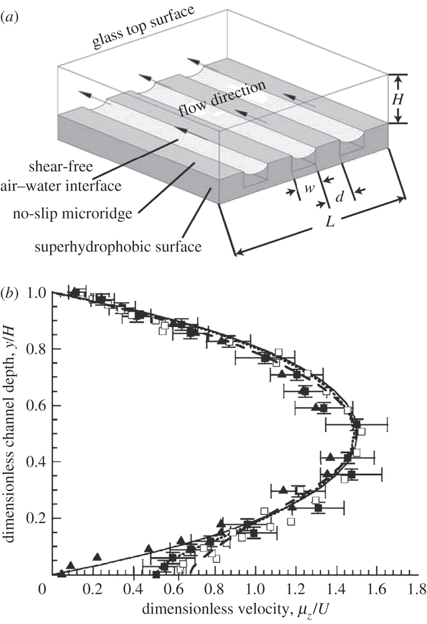
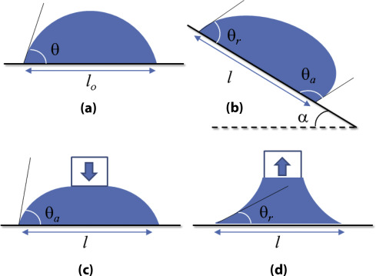
But what happens near
superhydrophobic surfaces?
And at the triple line of a
drop sliding down an incline?
CFD & Optimization
Alessandro Bottaro
DICCA, University of Genova

Slide 26

An excursion into the
microscopic world
CFD & Optimization
Alessandro Bottaro
DICCA, University of Genova

Slide 27
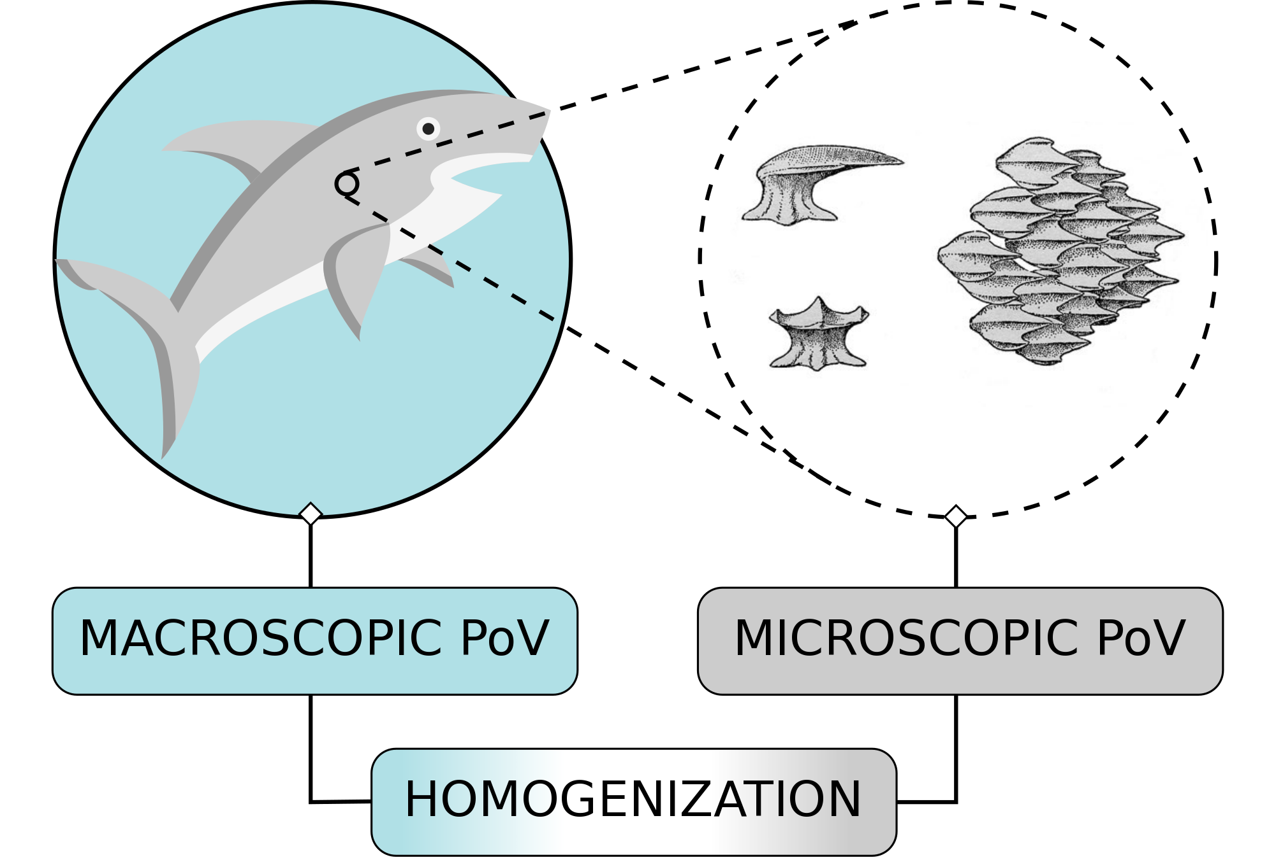
An excursion into the
microscopic world
CFD & Optimization
Alessandro Bottaro
DICCA, University of Genova
L
l

Slide 28
free fluid
CFD & Optimization
Alessandro Bottaro
DICCA, University of Genova
surface layer (eventually of zero thickness)
microscopic equations
wall (or porous or poro-elastic matrix)
macroscopic picture

Slide 29
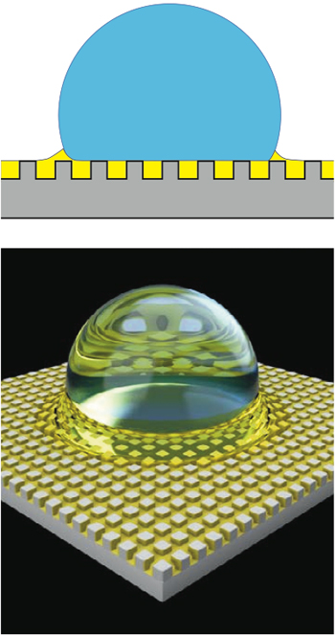
CFD & Optimization
Alessandro Bottaro
DICCA, University of Genova
porous or poroelastic material

Slide 30
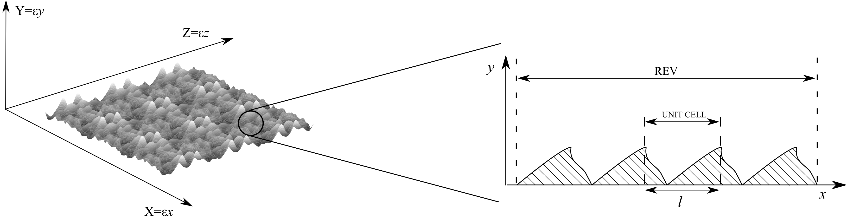
DEALING WITH ROUGH WALLS
CFD & Optimization
Alessandro Bottaro
DICCA, University of Genova

Slide 31
DEALING WITH ROUGH WALLS
CFD & Optimization
Alessandro Bottaro
DICCA, University of Genova
Assume that near the wall the microscopic pressure gradient is equilibrated by viscous diffusion:
and normalize equations accordingly. Also, introduce micro- and macro scales (x, X) with X_{i} = ε x_{i} and expand:

Slide 32
DEALING WITH ROUGH WALLS
CFD & Optimization
Alessandro Bottaro
DICCA, University of Genova
The governing equations at leading order in ε read:
with the microscopic Reynolds number

Slide 33
DEALING WITH ROUGH WALLS
CFD & Optimization
Alessandro Bottaro
DICCA, University of Genova
Use Lagrange-Green identity:

Slide 34
DEALING WITH ROUGH WALLS
CFD & Optimization
Alessandro Bottaro
DICCA, University of Genova
All variables in the b.t. are evaluated at

Slide 35
DEALING WITH ROUGH WALLS
CFD & Optimization
Alessandro Bottaro
DICCA, University of Genova
Orthogonality condition:
Definition of surface average:

Slide 36
DEALING WITH ROUGH WALLS
CFD & Optimization
Alessandro Bottaro
DICCA, University of Genova
Problem 1:
Problem 2:

Slide 37
DEALING WITH ROUGH WALLS
CFD & Optimization
Alessandro Bottaro
DICCA, University of Genova
Problem 1:
The boundary terms b.t. yield:
which in outer variables becomes:
with a function of the adjoint variable

Slide 38
DEALING WITH ROUGH WALLS
CFD & Optimization
Alessandro Bottaro
DICCA, University of Genova
Problem 2:
Both Navier slip lengths can be evaluated provided a model of the Reynolds stresses is available at the edge of the roughness sublayer.

Slide 39
DEALING WITH ROUGH WALLS
CFD & Optimization
Alessandro Bottaro
DICCA, University of Genova
If (hydrodynamically smooth case) the roughness sublayer is embedded within the viscous layer.
In this case, the slip lengths are only function of the roughness geometry.

Slide 40
DEALING WITH ROUGH WALLS
CFD & Optimization
Alessandro Bottaro
DICCA, University of Genova
G. Zampogna, J. Magnaudet & AB, submitted 2018

Slide 41
DEALING WITH ROUGH WALLS
CFD & Optimization
Alessandro Bottaro
DICCA, University of Genova
λ_{x}
The microscopic problem

Slide 42
DEALING WITH ROUGH WALLS
CFD & Optimization
Alessandro Bottaro
DICCA, University of Genova
The macroscopic problem

Slide 43
DEALING WITH ROUGH WALLS
CFD & Optimization
Alessandro Bottaro
DICCA, University of Genova

Slide 44
DEALING WITH ROUGH WALLS
CFD & Optimization
Alessandro Bottaro
DICCA, University of Genova
Re^{out} = 100

Slide 45
DEALING WITH ROUGH WALLS
CFD & Optimization
Alessandro Bottaro
DICCA, University of Genova
Re^{out} = 100

Slide 46
DEALING WITH ROUGH WALLS
CFD & Optimization
Alessandro Bottaro
DICCA, University of Genova

Slide 47
DEALING WITH ROUGH WALLS
CFD & Optimization
Alessandro Bottaro
DICCA, University of Genova
Values very close ! Must try increasing the roughness Reynolds number …

Slide 48
DEALING WITH ROUGH WALLS
Re^{out} = 100
CFD & Optimization
Alessandro Bottaro
DICCA, University of Genova
Re^{out} = 1000

Slide 49
DEALING WITH ROUGH WALLS
CFD & Optimization
Alessandro Bottaro
DICCA, University of Genova
RSP
ESP (with Navier slip conditions)

Slide 50
DEALING WITH ROUGH WALLS
CFD & Optimization
Alessandro Bottaro
DICCA, University of Genova
PSD SIGNALS USING THE NAVIER CONDITION WITHOUT INNER-OUTER INTERACTION TERMS DO NOT MATCH DNS (Re^{out} = 1000 AND Re ARE SIMPLY TOO LARGE)
MUST FIND A STRATEGY TO HANDLE LARGE REYNOLDS NUMBERS (Re = O(1) AND LARGER) CLOSING THE REYNOLDS STRESS TERM

Slide 51
CONCLUSIONS
Regular rough walls can be described by Navier slip.
The slip tensor arises from a microscopic problem which is defined uniquely on the basis of the roughness geometry for hydrodynamically smooth walls (Re → 0)
ONGOING:
Close Reynolds stress term to extend Navier slip concept to transitionally rough and fully rough walls
Couple to roughness deformations (linear elastic surface protrusions, small deformations occurring over a large scale L, i.e. honami)
CFD & Optimization
Alessandro Bottaro
DICCA, University of Genova

