Slide 1
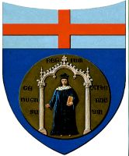
Le rôle d’appendices passifs (poils, plumes, écailles …) sur la propulsion animale
A. Bottaro (DICCA, Université de Gênes)
Collaborateurs:
S. Bagheri (KTH, Stockholm)
A. Mazzino (DICCA, Genova)
Z. Orlando (DICCA, Genova)
Toulouse, Juin 10, 2013

Slide 2
The role of passive appendages (hair, feathers, scales …) on animal propulsion
A. Bottaro (DICCA, University of Genova)
Collaborators:
S. Bagheri (KTH, Stockholm)
A. Mazzino (DICCA, Genova)
Z. Orlando (DICCA, Genova)
Toulouse, June 10, 2013

Slide 3
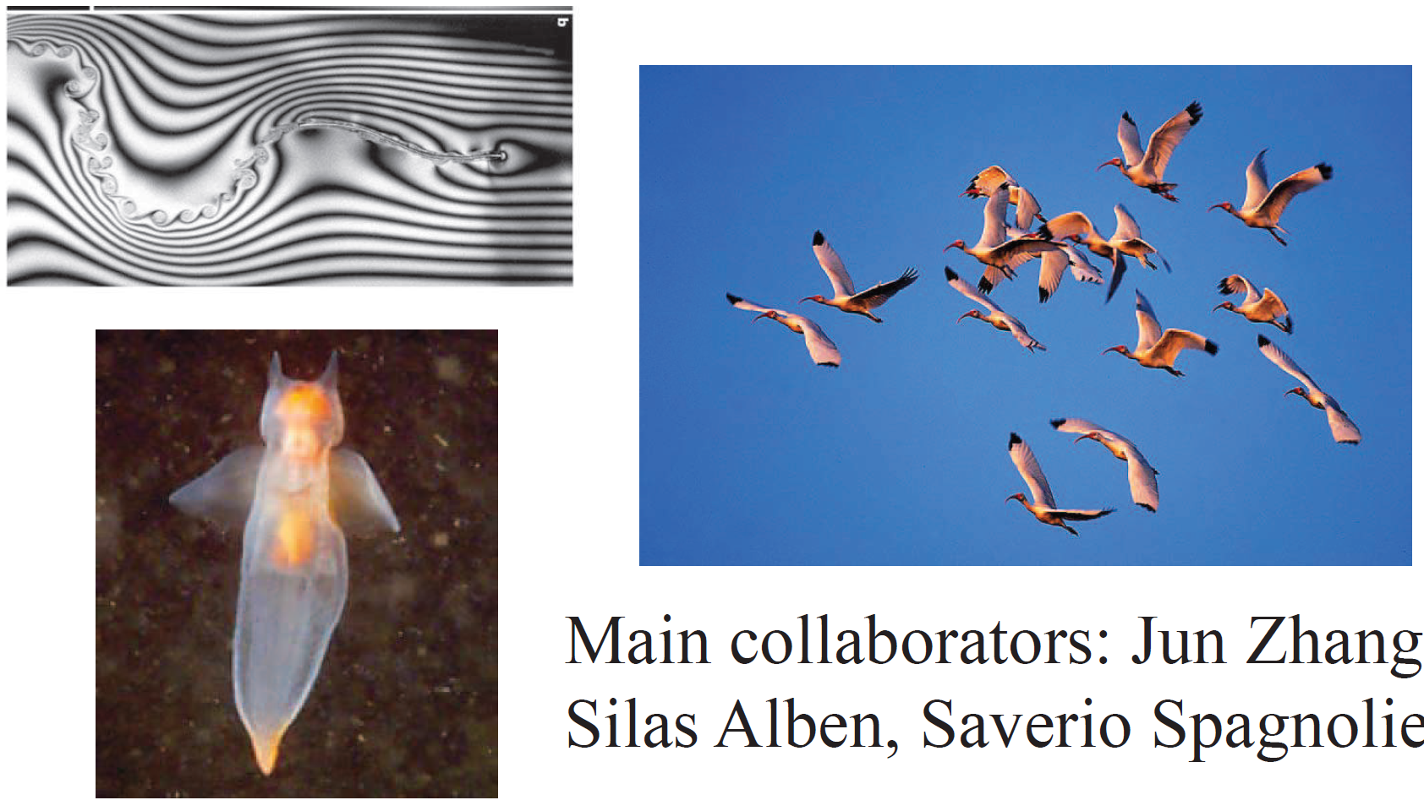
Advantage/disadvantage of passive flexible parts/appendages in animal propulsion?

Slide 4
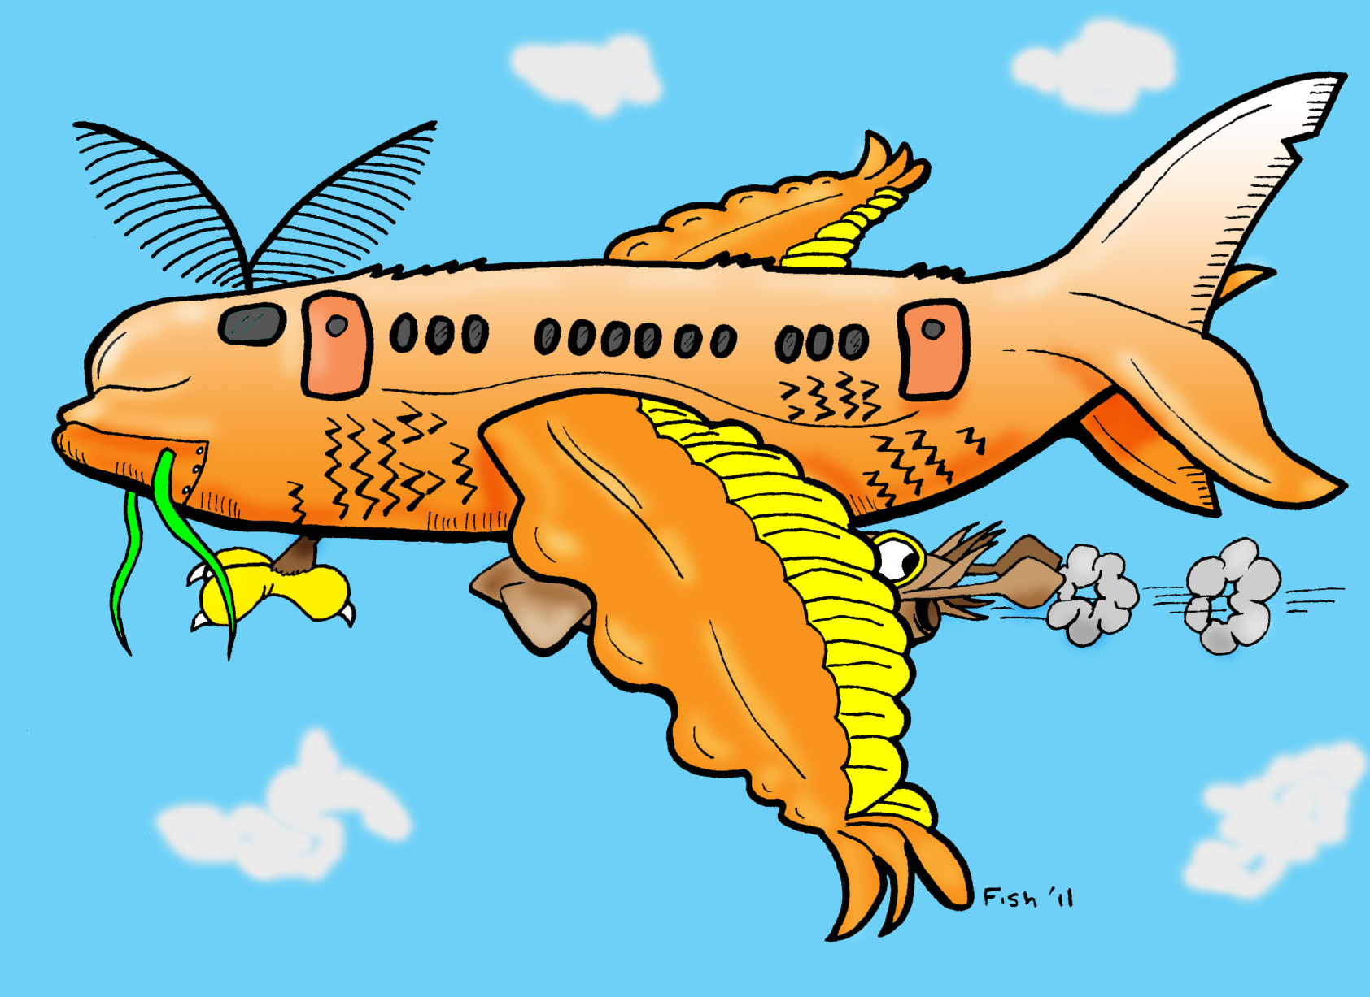

Slide 5
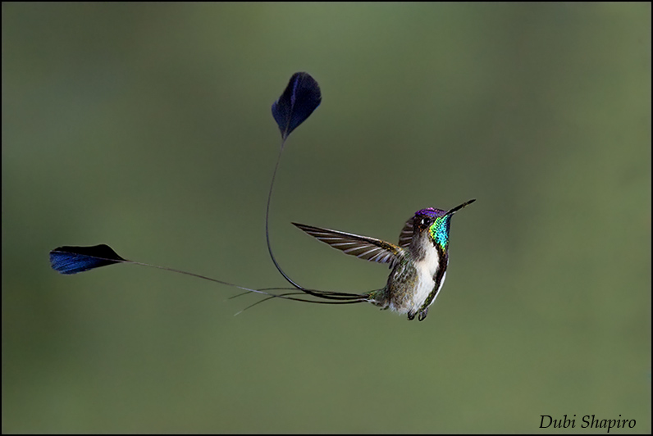
Loddigesia mirabilis
Marvellous Spatuletail
What are those four long tail feathers good for?

Slide 6
Loddigesia mirabilis
Marvellous Spatuletail
What are those four long tail feathers good for?
Just for mating purposes???!!!
http://ibc.lynxeds.com/species/marvellous-spatuletail-loddigesia-mirabilis
http://www.bbc.co.uk/nature/life/Marvellous_Spatuletail

Slide 7
In which “world” do we live?

Slide 8
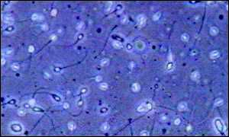
Re << 1, micro-organisms use
non-reciprocal waves to move
(no inertia → symmetry under
time reversal)

Slide 9
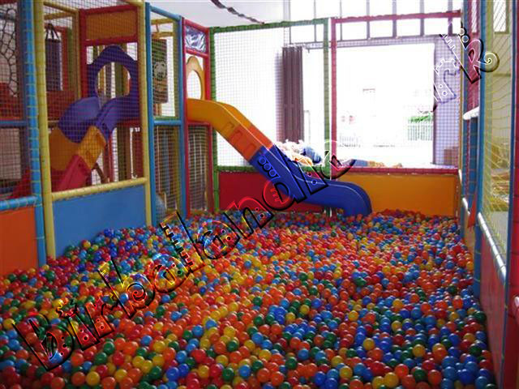
Re << 1, micro-organisms use
non-reciprocal waves to move
(no inertia → symmetry under
time reversal)

Slide 10
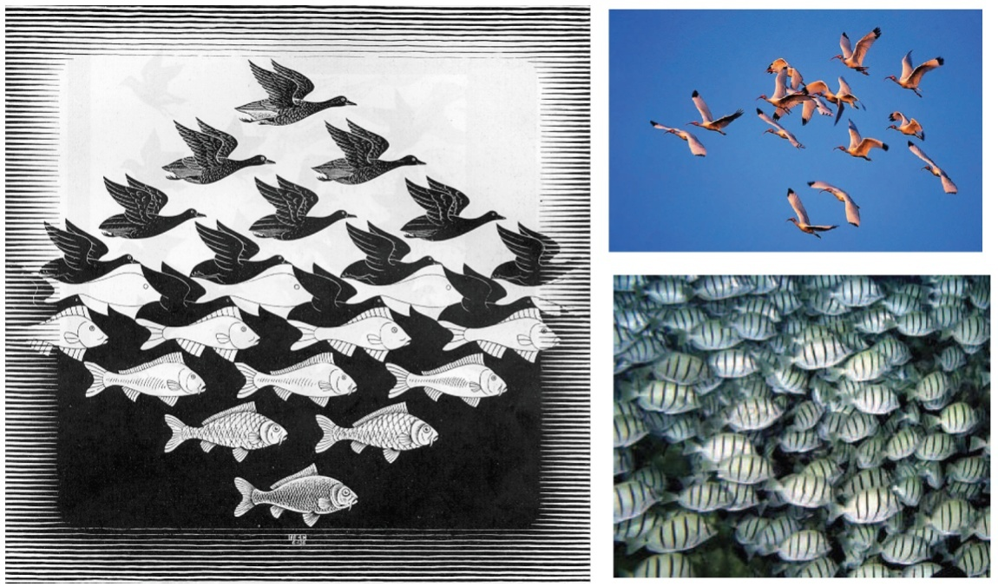
Re << 1, micro-organisms use
non-reciprocal waves to move
(no inertia → symmetry under
time reversal)
Re >> 1, birds/fish use reciprocal
flapping for lift and/or propulsion

Slide 11
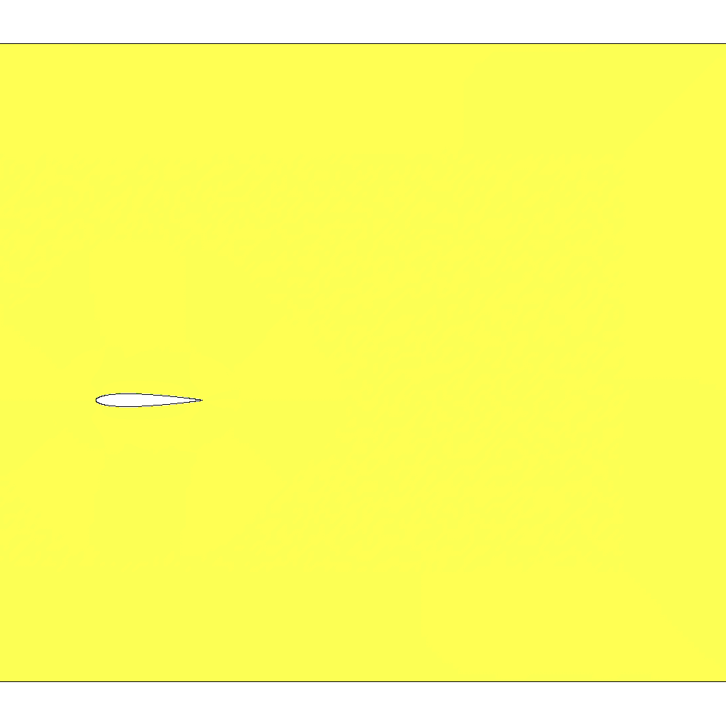
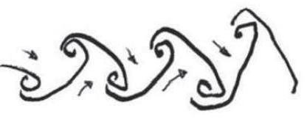
Re << 1, micro-organisms use
non-reciprocal waves to move
(no inertia → symmetry under
time reversal)
Re >> 1, birds/fish use reciprocal
flapping for lift and/or propulsion
Heaving, rigid, symmetric foil
(thrust)
(inverted von Karman vortex street)

Slide 12
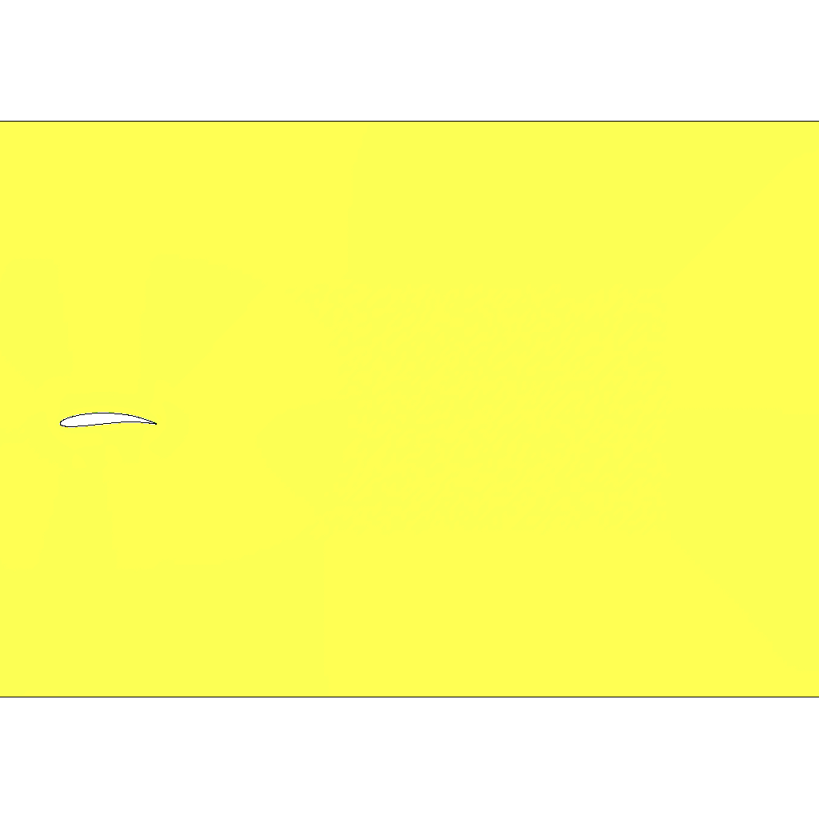
Re << 1, micro-organisms use
non-reciprocal waves to move
(no inertia → symmetry under
time reversal)
Re >> 1, birds/fish use reciprocal
flapping for lift and/or propulsion
Heaving, rigid, cambered foil
(plus lift)

Slide 13

Re << 1, micro-organisms use
non-reciprocal waves to move
(no inertia → symmetry under
time reversal)
Re >> 1, birds/fish use reciprocal
flapping for lift and/or propulsion
Heaving, flexible, cambered foil
(plus …)
J. Guerrero, PhD Thesis, 2009, UNIGE

Slide 14
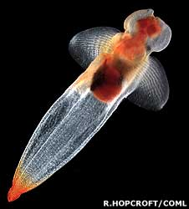
Some animals live between these worlds: Re ≈ 10 - 1000
(and present flexible appendages)
Clione Antarctica (“sea slug”), a marine
mollusc which switches mobility strategy
with adulthood:
rowing cilia → flapping wings
Childress & Dudley, JFM 2004

Slide 15
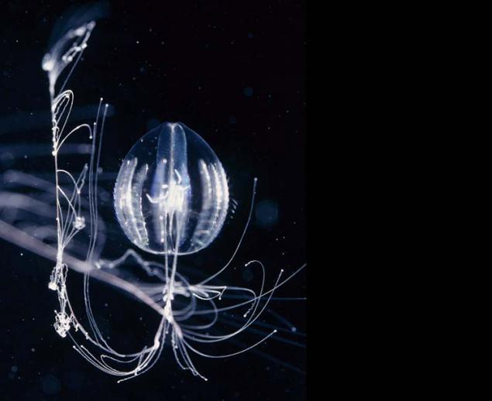
Some animals live between these worlds: Re ≈ 10 - 1000
(and present flexible appendages)
Clione Antarctica (“sea slug”), a marine
mollusc which switches mobility strategy
with adulthood:
rowing cilia → flapping wings
Childress & Dudley, JFM 2004
Pleurobrachia Pileus (comb-jelly), a
member of the Phylum Ctenophora
which moves in water thanks to the rythmic beating of eight rows of cilia.

Slide 16
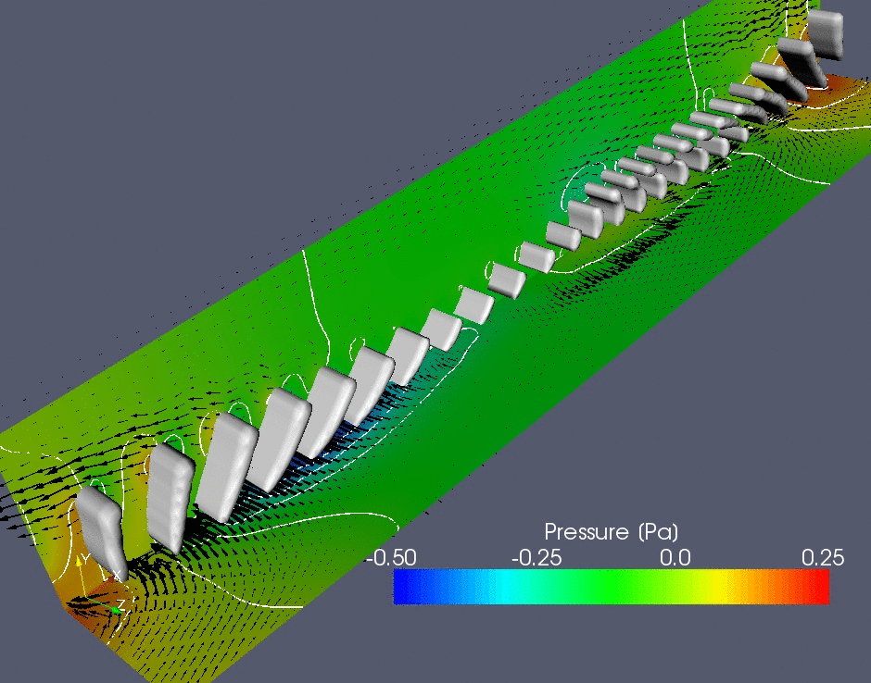
Some animals live between these worlds: Re ≈ 10 - 1000
(and present flexible appendages)
Pleurobrachia Pileus (comb-jelly), a
member of the Phylum Ctenophora
which moves in water thanks to the rythmic beating of eight rows of cilia
Long tentacles for feeding …
Dauptain, Favier & Bottaro, JFS 2008

Slide 17
Some animals live between these worlds: Re ≈ 10 - 1000
(and present flexible appendages)
Re₁ ∼ f L²/ν ∼ 900 with f ∼ 20 Hz and L ∼ 3 cm
Re₂ ∼ U L/ν ∼ 1500 with U ∼ 1 m/s

Slide 18
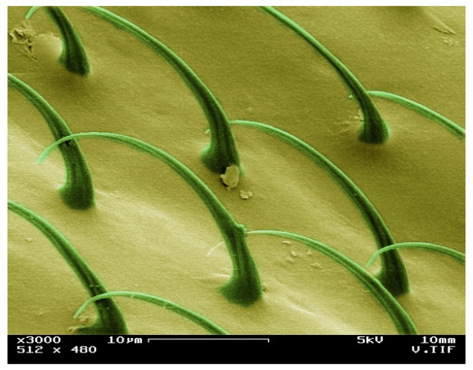
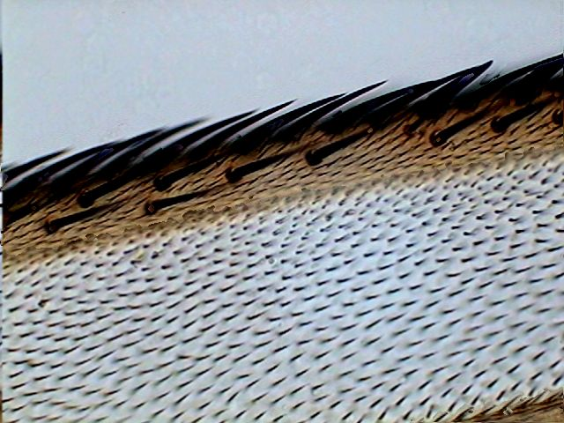
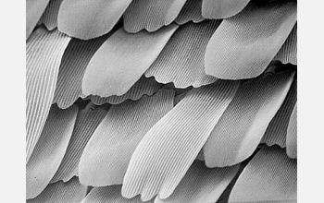
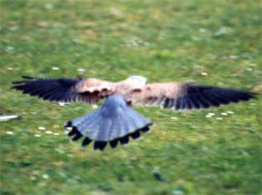
fly mosquito
butterfly “pop-up” feathers
In Nature “rough” is rule, not exception …

Slide 19
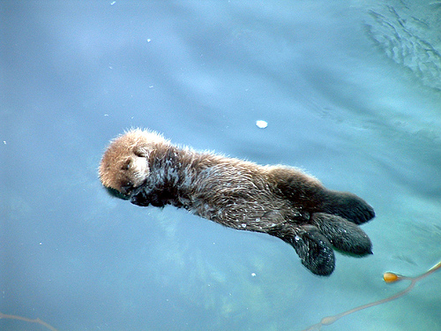
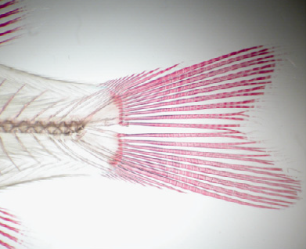
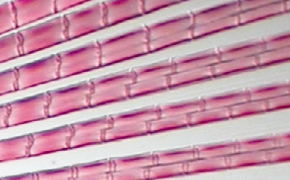
sea otter
Caudal (tail) of a sunfish made competition swim suits …
by jointed bony segments
In Nature “rough” is rule, not exception …

Slide 20
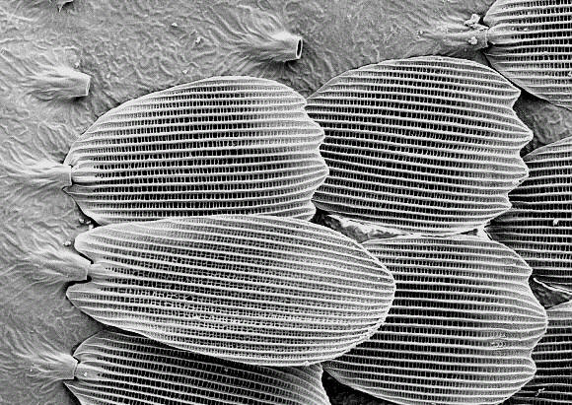
Butterfly and moth microstructure of the wings
Sharks
Penguins
Seals
Left: electron microscope image of butterfly scales. Right: perspective view (with dimensions) with details of a scale. UL: upper lamina; LL: lower lamina; T: trabecula.

Slide 21
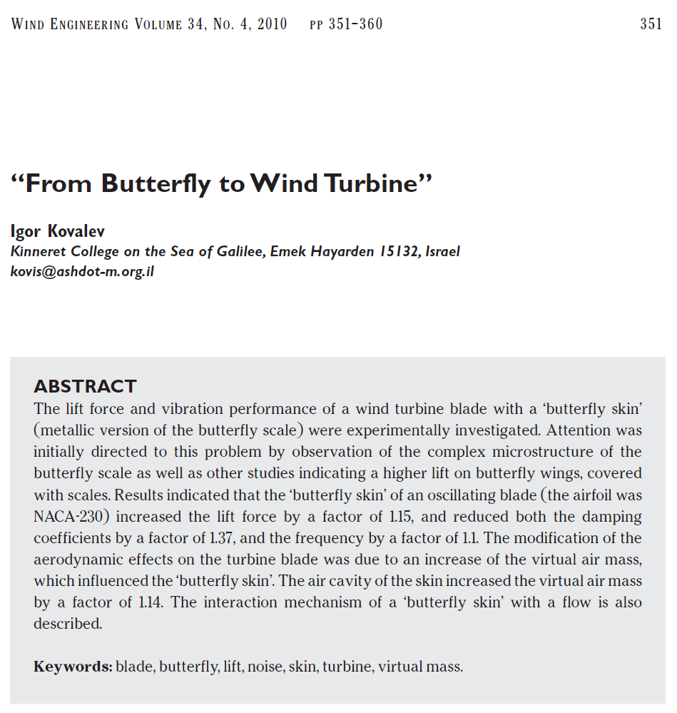
Butterfly and moth microstructure of the wings
Sharks
Penguins
Seals

Slide 22
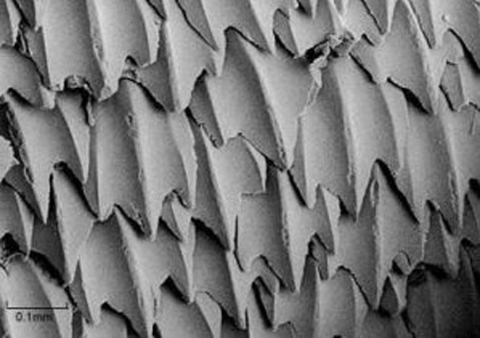
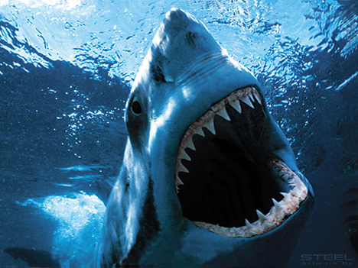
Shark skin paint!
The coating that reduces skin friction drag
(Fraunhofer, Bremen)
denticle
Sharks
Penguins
Seals

Slide 23
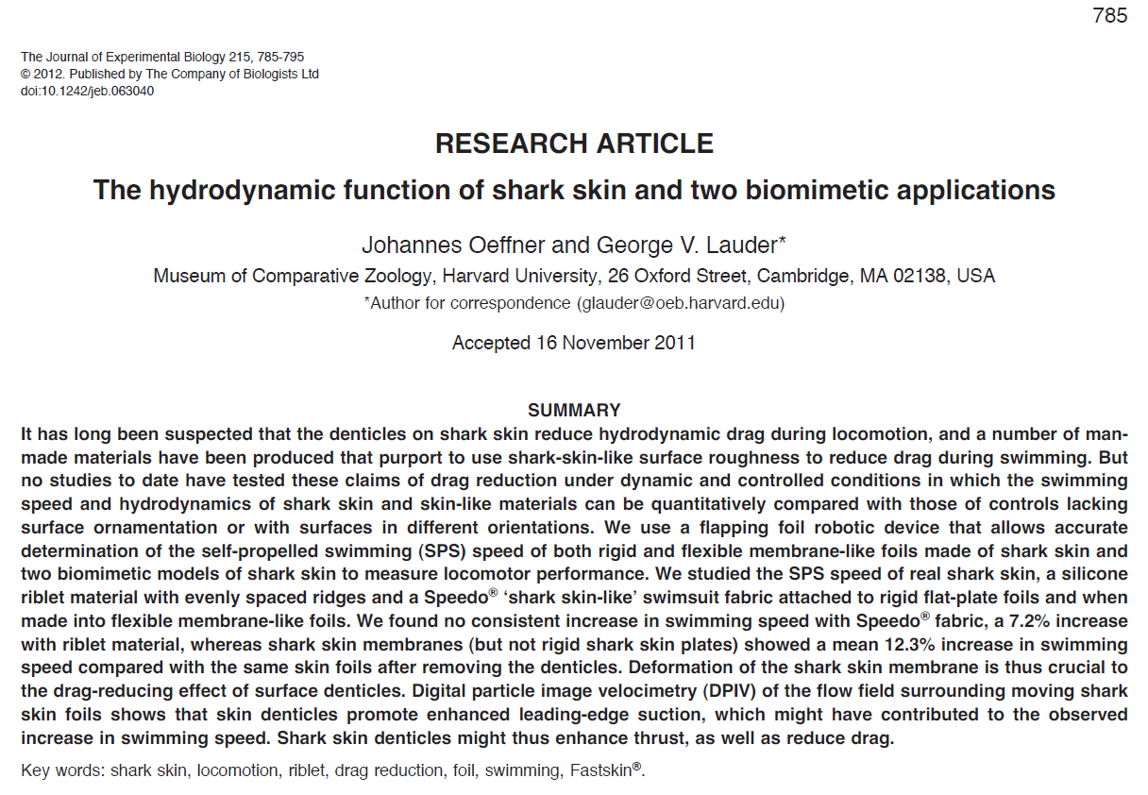
In fact, denticles enhance thrust when the
shark’s body undulates (i.e. it is flexible),
they do not simply reduce drag!
Sharks
Penguins
Seals

Slide 24
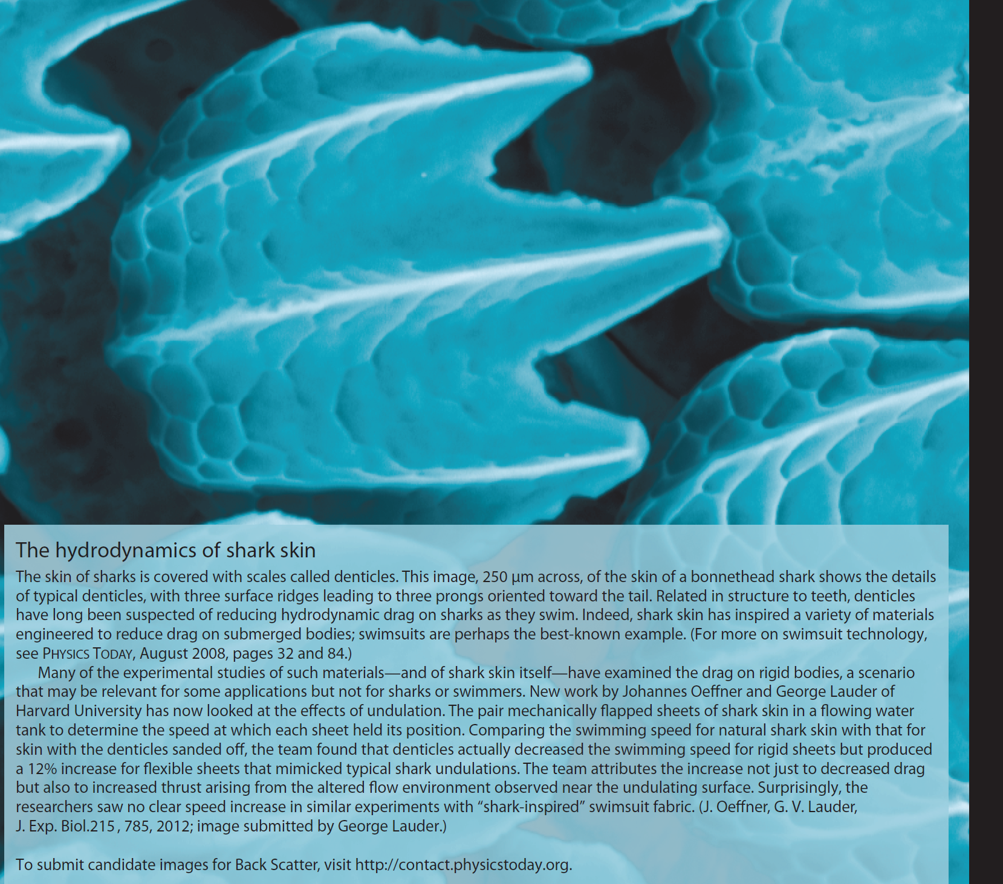
Sharks
Penguins
Seals

Slide 25
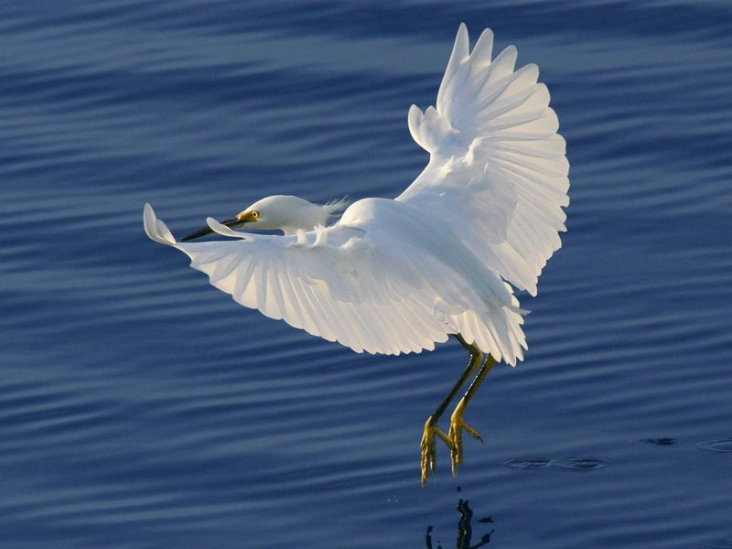
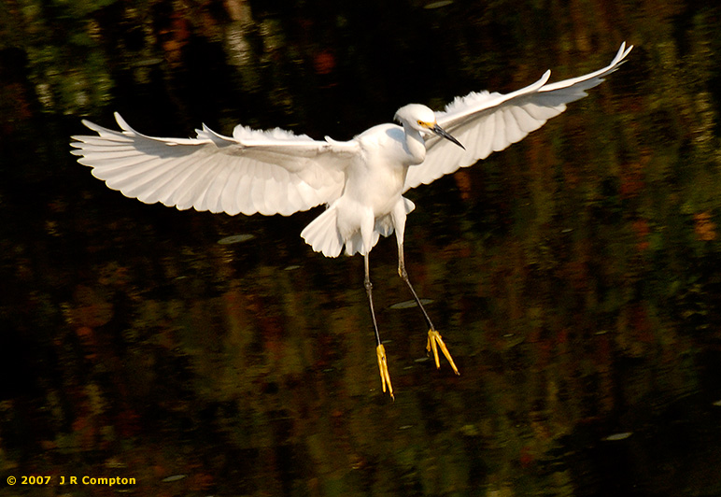
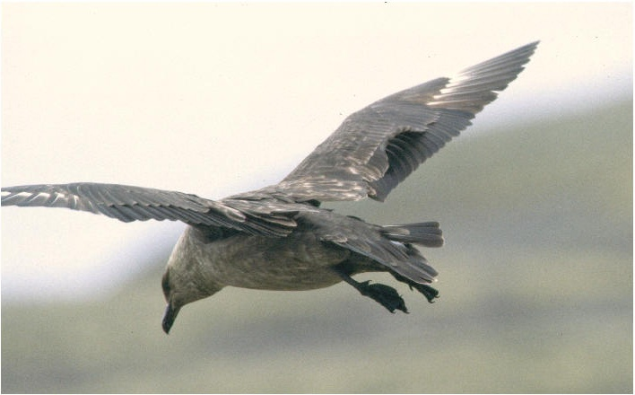
Are coverts also a passive mean to increase lift?
And reduce pressure drag?

Slide 26
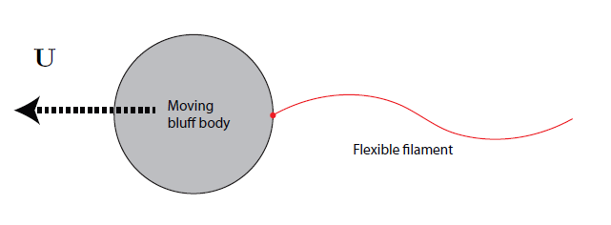
How do a “free” body and a fluid interact as Re
What is the role of apparently inert
filaments/cilia/tentacles/scales?

Slide 27
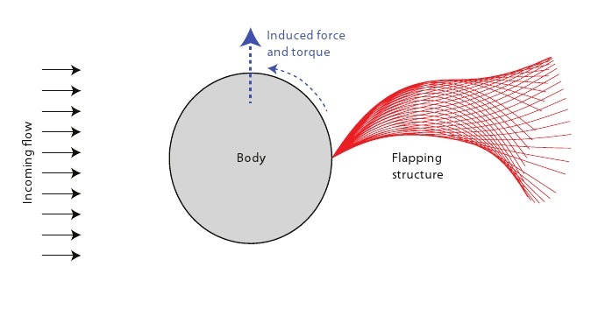
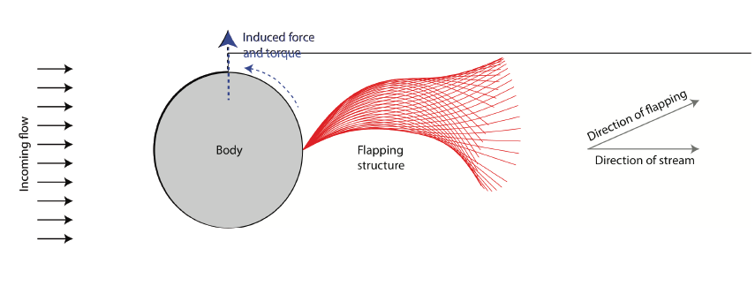
Symmetry breaking!
Filament flap asymmetrically:
- induced force and torque
- reduced drag

Slide 28
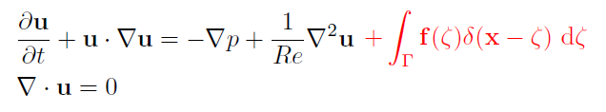
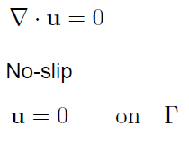
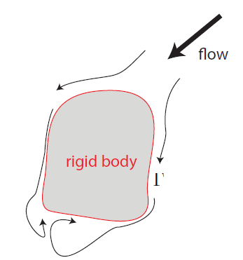
The numerical method

Slide 29
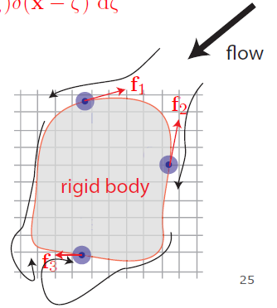
The numerical method: IBM
Flow field: Eulerian grid
Boundary: Lagrangian points
Boundary force to enforce
no-slip condition
Projection method
(Taira & Colonius, JCP 2005)

Slide 30
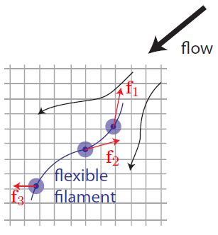

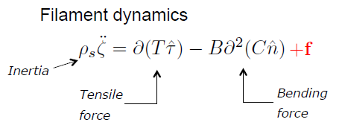
The numerical method: IBM + the flexible filament
ζ = ζ(s,t) s: arclength
: Euler-Bernoulli
: Euler-Bernoulli
Peskin, Acta Numerica 2002
Kim & Peskin, PoF 2007

Slide 31
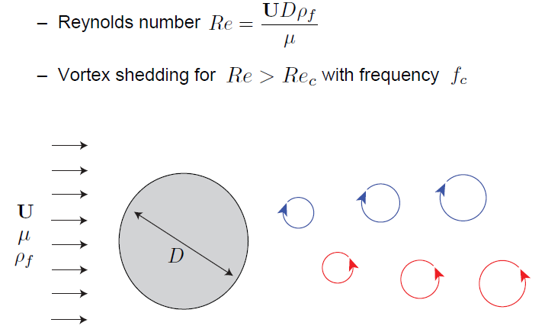
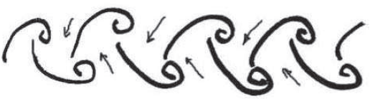
The cylinder alone: symmetric wake
(classical von Karman vortex street)
Williamson, ARFM 1996

Slide 32
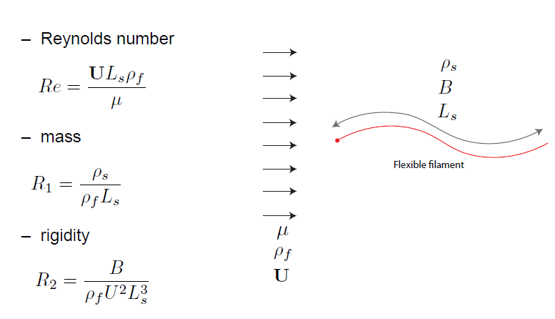
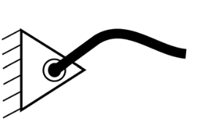
The filament alone: symmetric flapping
T = ζ _{ss} = ζ _{sss} = 0 @ s = L_{s} (filament free end)
ζ = ζ _{ss} = 0 @ s = 0 (hinged position)

Slide 33
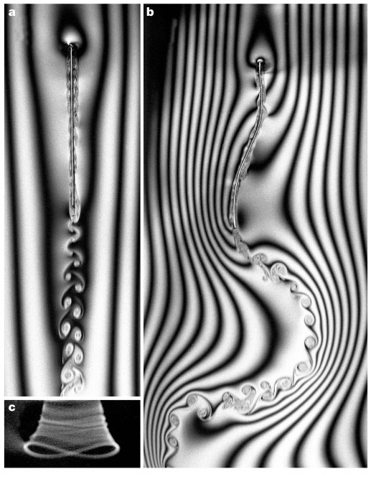
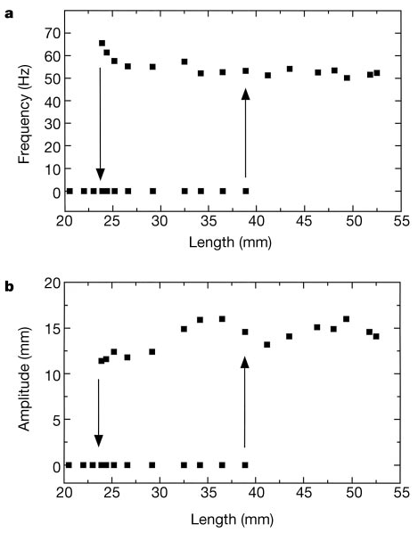
The filament alone (soap film experiments)
flapping
stretched
Zhang, Childress, Libchaber & Shelley, Nature 2000
Shelley & Zhang, ARFM 2011

Slide 34
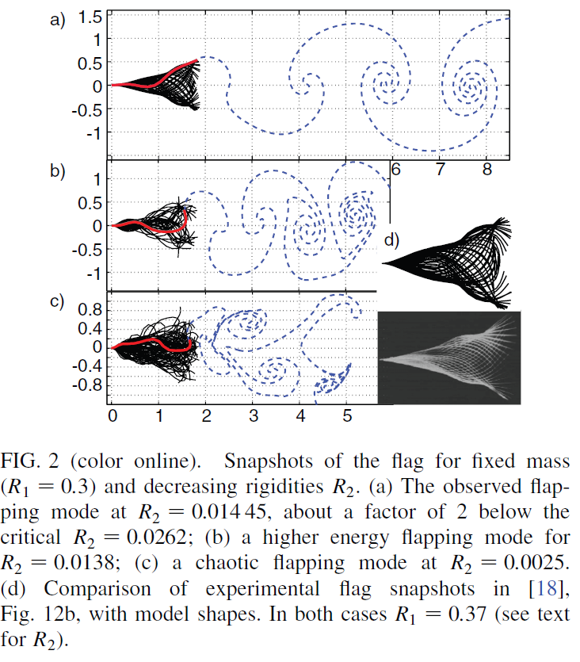
The filament alone (theory)
Inviscid flow theory: vortex sheet (filament) + shed free vortex sheet → Biot-Savart integral (for velocity ┴ to the filament) + Euler equation
R₂
Alben & Shelley, PRL 2008

Slide 35
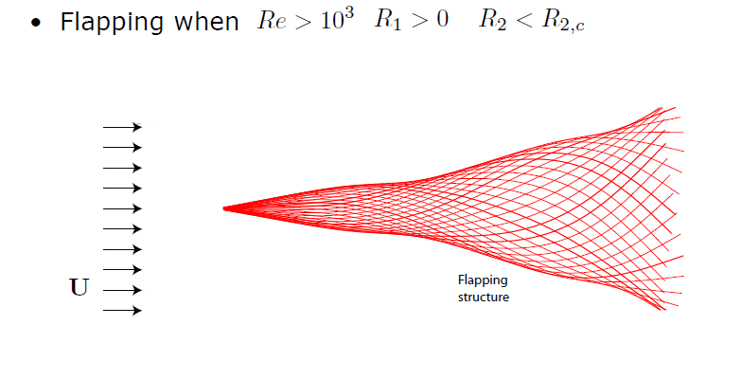
The filament alone (numerical simulations)

Slide 36
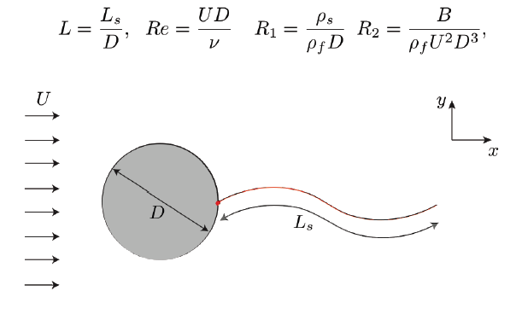
Cylinder + filament: something happens …

Slide 37
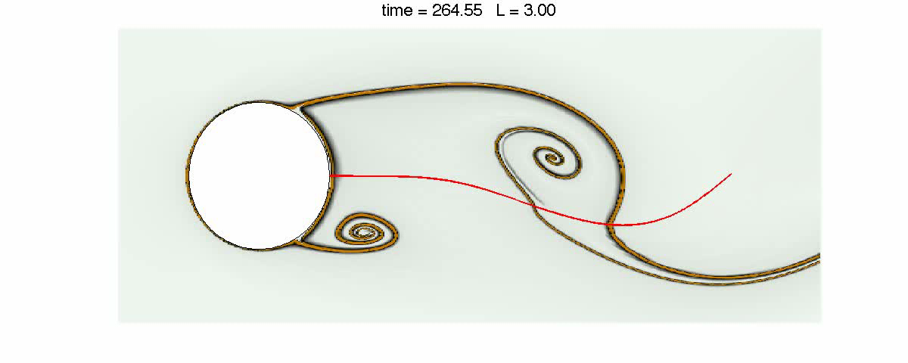
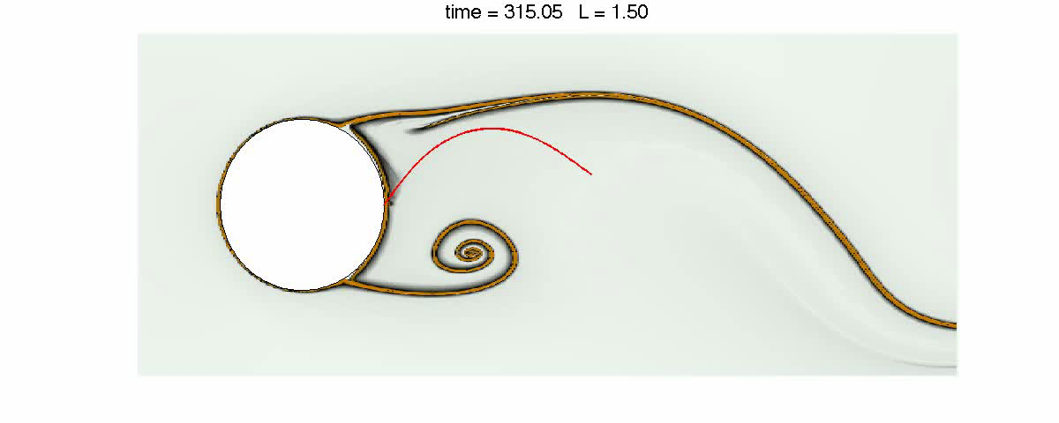
Re = 100, R₁ = 0.1, R₂ = 0.005, L = 3 and L = 1.5
Bagheri, Mazzino & Bottaro, PRL 2012

Slide 38
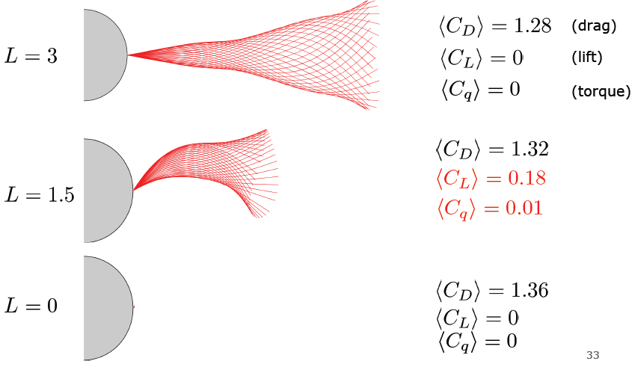

Slide 39

Long, flexible
Short, flexible
Short, rigid
increasing R₂ → increased rigidity of the structure

Slide 40


Slide 41


Choice of observable
Rigid filament: R₂ = 0.1
Flexible filament: R₂ = 0.005

Slide 42

A symmetry-breaking bifurcation occurs when vortices and structures resonate …

Slide 43

Beam equation

Slide 44


Resonance condition
filament with slow reaction time
filament reacts instantaneously

Slide 45

ss

Slide 46

Resonance

Slide 47

Resonance
L_{r} filament L_{c}
energy

Slide 48

Can filaments increase drift?

Slide 49


Can filaments reduce drag “optimally” (because of
compliance) as opposed, i.e., to the (sub-optimal)
pressure drag reduction of golf/tennis/baseball balls?

Slide 50
It is important the presence of dimples/roughness/etc.,
but compliance/elasticity is also very important …
Sharks
Penguins
Seals

Slide 51

New work just started: a filament at a wall in a channel with an oscillating pressure gradient
Sharks
Penguins
Seals

Slide 52


“hydroelastic steady streaming”
Penguins
Seals
Velocity of each vortex core is induced by
vortex of opposite circulation (Biot-Savart)

Slide 53
… but this is another story!

Slide 54

THANK YOU!

