Slide 1
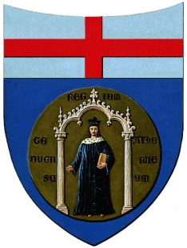
Master Thesis in Mechanical Engineering
13/12/2013
University of Genoa
Faculty of Engineering
DEVELOPMENT OF A TOOL FOR THE PREDICTION OF TRANSITION TO TURBULENCE OVER SMALL AIRCRAFT WINGS
Advisor: Prof. Jan Pralits
Co-Advisor: Eng. Christophe Favre
Co-Advisor: Prof. Alessandro Bottaro
Candidate: Marina Bruzzone

Slide 2
OUTLINE
Introduction and Motivation
Theory
Methodology developed
Test cases validation in 2D
Test case validation in 3D
Conclusions and Future Work

Slide 3
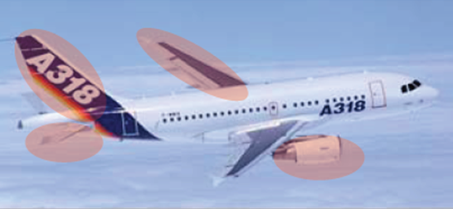
INTRODUCTION & MOTIVATION
Increase of aircraft efficiency to improve the performances
In aerodynamics the matter is friction drag prediction
Drag is directly linked to transition and turbulence
How and when a flow becomes turbulent is a classic unsolved problem in fluid mechanics
Determine the transition location
on the wings, winglets, tail, fin and
nacelles reduces fuel consumption of 15%
Validate a transition prediction process
on 2D profiles and apply it on a 3D geometry.

Slide 4
THEORY

Slide 5
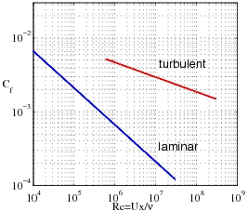
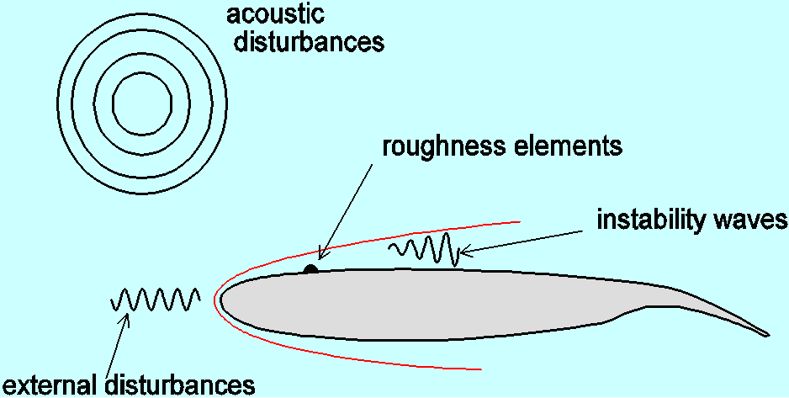
THEORY
LAMINAR FLOW on the wings reduces the drag and hence the fuel consumption
RECEPTIVITY: disturbances in the free stream enter the boundary layer as unsteady fluctuations

Slide 6
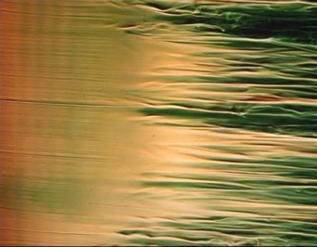
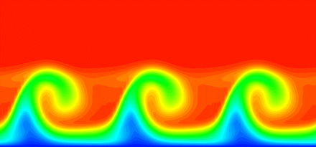
THEORY
Disturbances enter the laminar boundary layer.
Some of them are amplified and will be responsible for
transition.
Tollmien-Schlichting waves: (2D flows)
  Instabilities develop as wave-like disturbances.
  Their periodic form grows exponentially.
  The first stage can be studied by linear theory.
  After they reach a finite amplitude and a random character.
CrossFlow instabilities: (3D flows)
  Typical of 3D flow so, for instance for a swept wing.
  Qualitatively the same phenomena but propagated
  in a wide range of directions
  CF instabilities appear as co-rotating vortices

Slide 7
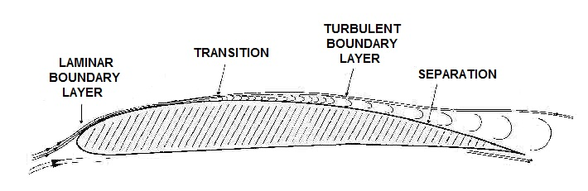
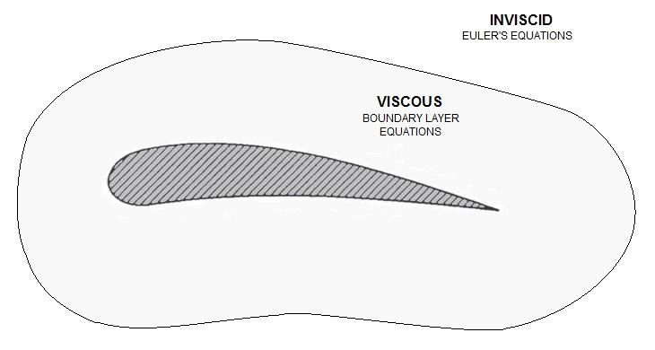
THEORY
Viscosity influences a very thin layer
in the immediate neighborhood of the
solid wall.
In boundary layer region the velocity increases from zero at the wall to the external velocity in the outer region, which is the velocity of the frictionless flow.
Prandtl’s idea of boundary layer is to
divide the flow into two regions, the
outer one is approximated with no viscosity
and one internal where the friction must be
taken into account.

Slide 8

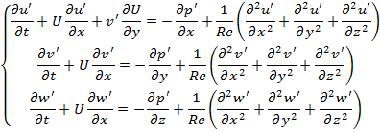
THEORY
Considering variables composed by a base flow part and a fluctuating one, for
  parallel
  two-dimensional
  incompressible flow
Perturbations are dependent on x, y, z coordinate and on the time (disturbances are unsteady).
Continuity and Navier Stokes equations
are simplified considering:
  Non linear terms of disturbances
  can be neglected.
  Mean flow quantities scale is
  significantly bigger than the
  disturbances’ one.

Slide 9




THEORY
These equations are expressed through only two variables
  the normal velocity
  the vorticity
and in order to compute the range of unstable frequencies, linear stability theory introduces a solution that simulates the small sinusoidal disturbances in the form of
  amplitude, dependent only on y
  periodic wave along x and z directions
α streamwise wave number ( x – direction )
β spanwise wave number ( z – direction )
ω frequency
Knowing that , and expressing the derivative in y as D, the equations for v’ and for η’ are:
Orr - Sommerfeld Equation
Squire Equation

Slide 10
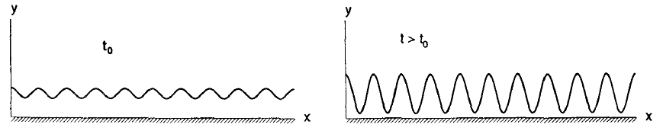
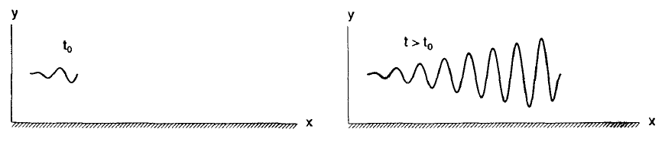
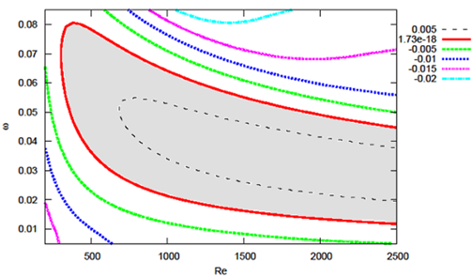




THEORY
Temporal Analysis Spatial Analysis
α,β ϵ ℝ ω,β ϵ ℝ
ω ϵ ℂ α ϵ ℂ
Perturbation velocity (SPATIAL ANALYSIS):
Stable
Neutral
Unstable
STABLE
UNSTABLE

Slide 11
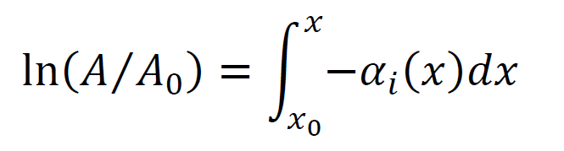
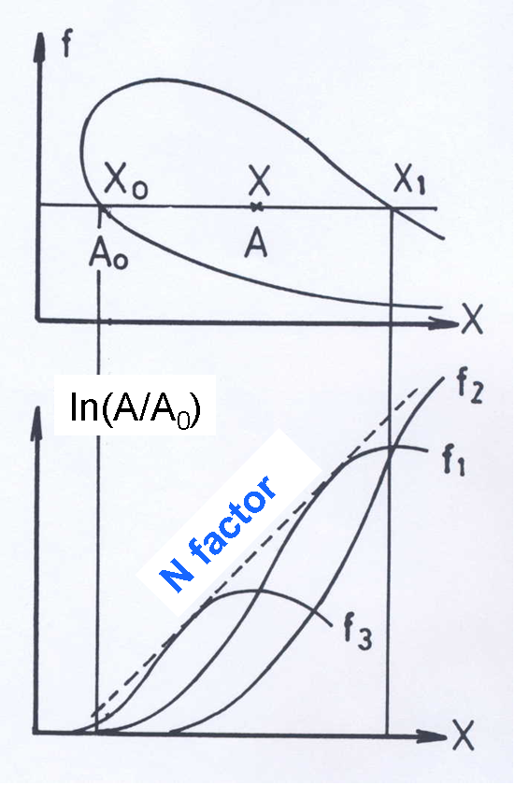

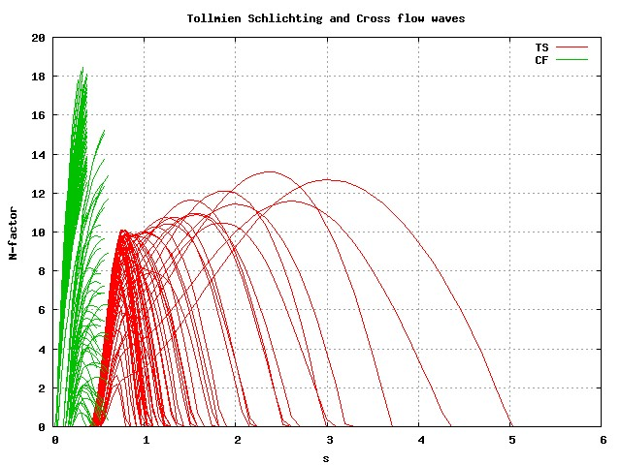
THEORY
At a given station, the total amplification rate of a spatially growing wave can be defined as:
A = wave amplitude
Ao = Xo position (where the wave becomes unstable)
The envelope of the
total amplification curves is:

Slide 12
METHODOLOGY DEVELOPED

Slide 13
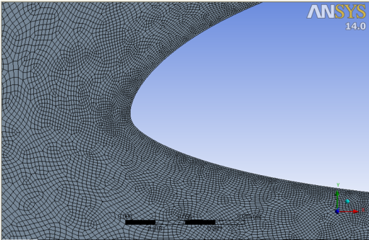
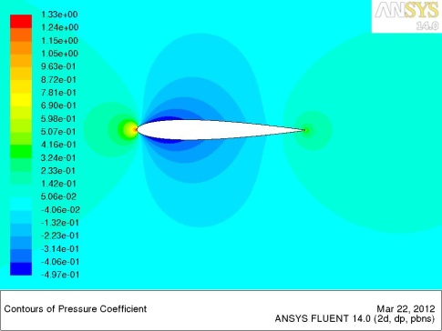
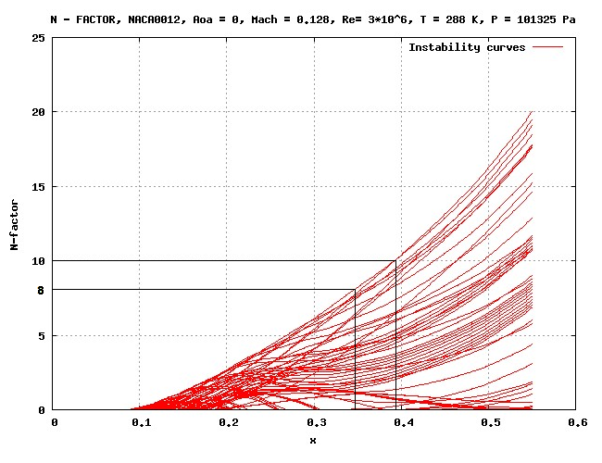
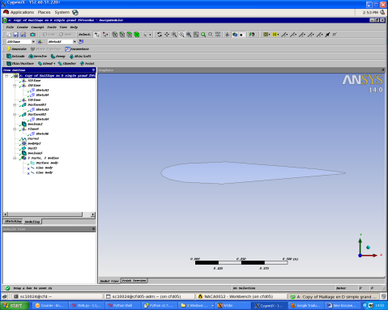
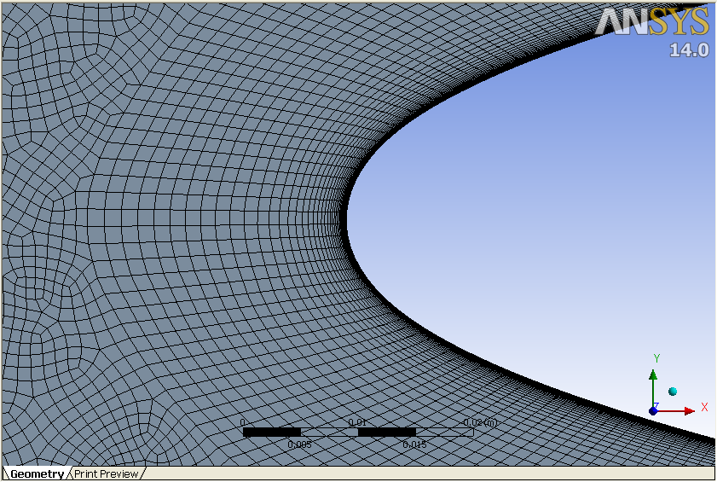
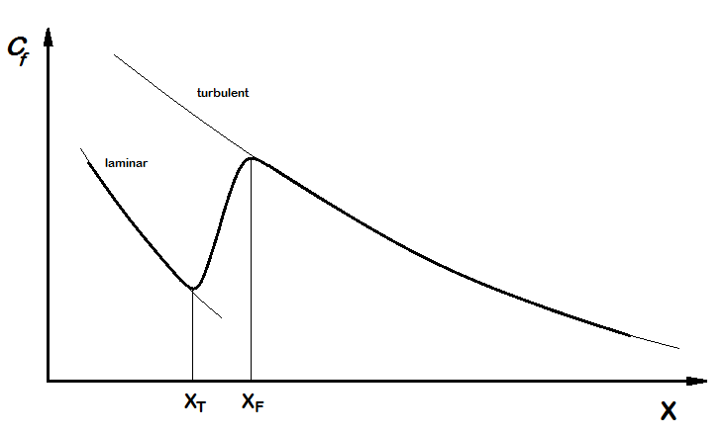
METHODOLOGY DEVELOPED
Design Modeler
GEOMETRY profile
Workbench
NO INFLATION
Fluent
INVISCID MODEL
Workbench
WITH INFLATION
Fluent
SST-TRANSITION MODEL
WING PROFILE
MESH
RESULTS
POST-PROCESS
bl3D
autoinit
NOLOT
Skin Friction

Slide 14
TEST CASES 2D

Slide 15
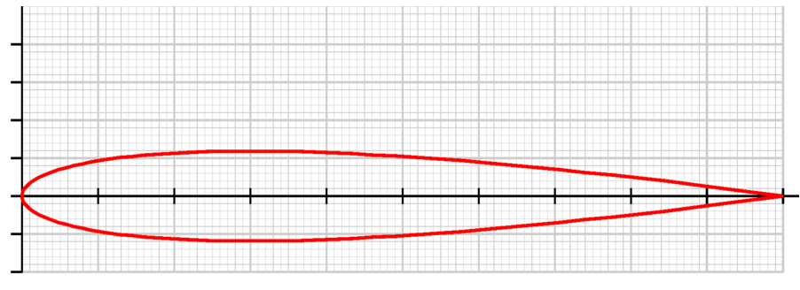
TEST CASES (2D)
NACA0012 Mach = 0.128, T = 288.15 K, P= 101325 Pa, Re =3x10^6
N-factor plot, amplification rate for AoA = 0°
EXPERTIMENTS vs Nolot

Slide 16
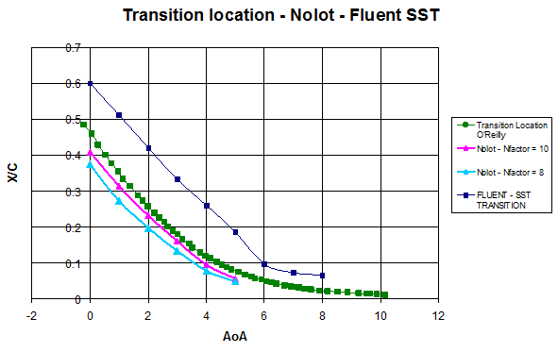
TEST CASES (2D)
NACA0012 Mach = 0.128, T = 288.15 K, P= 101325 Pa, Re =3x10^6
Viscous Calculation
Transition location in viscous case -> Cf
Rapid growth -> switch from laminar to turbulent

Slide 17
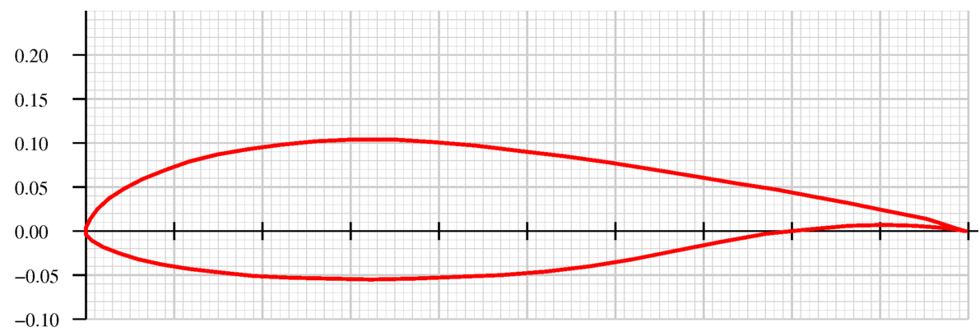
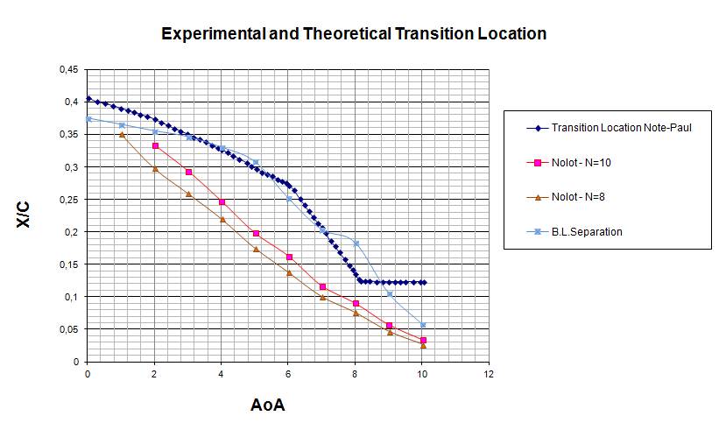
TEST CASES (2D)
NLF0416 Mach = 0.1, T = 288.15 K, P= 101325 Pa, Re =4x10^6
Transition location in
the article
(“Transition-Flow-
Occurrence-Estimation
“A New Method”
by Paul-Dan Silisteanu
and Ruxandra M. Botez )
is actually the
the separation
location.

Slide 18
TEST CASE 3D

Slide 19
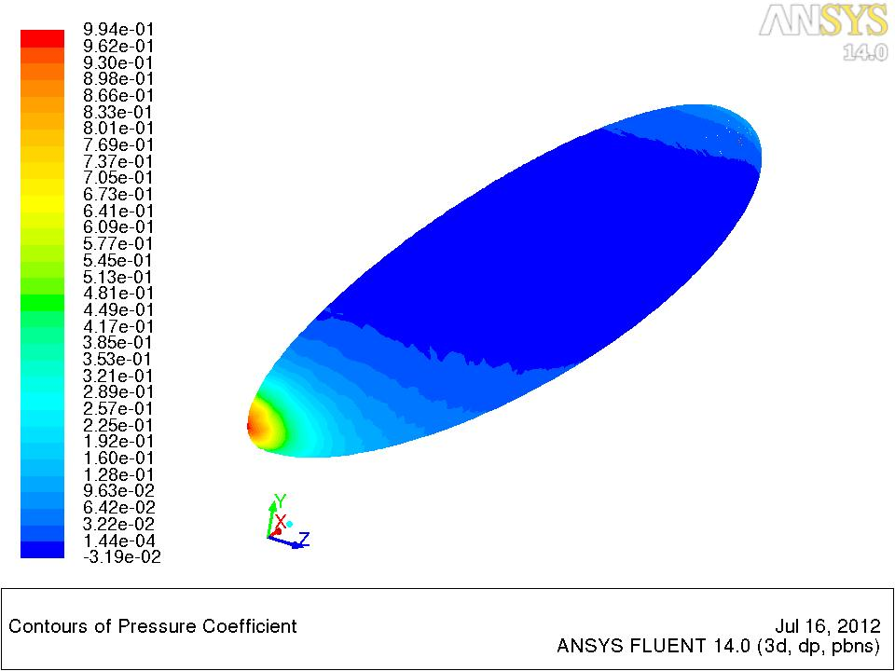
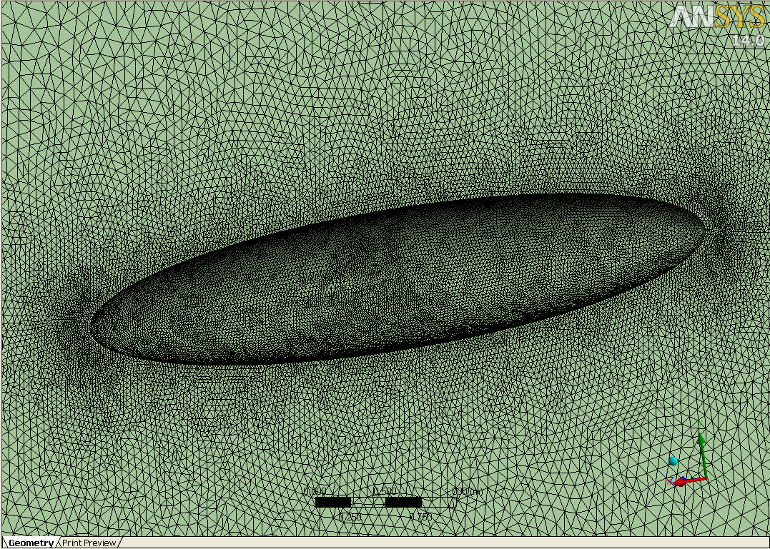
TEST CASE (3D)
SPHEROID Mach = 0.3, T = 281.53 K, P= 101325 Pa, Re =7.2x10^6
MESH and PRESSURE DISTRIBUTION
on the spheroid
(for inviscid calculation):

Slide 20
TEST CASE (3D)
SPHEROID Mach = 0.3, T = 281.53 K, P= 101325 Pa, Re =7.2x10^6
Cp distribution on the symmetry plane for :
AoA=0°
AoA=5°
AoA=10°
Nolot Transition location VS experiments :
only AoA=0°case → ok
the flow is still axisymmetric

Slide 21
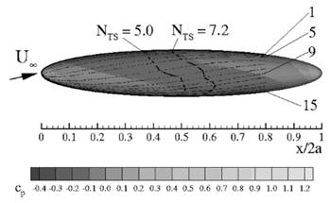
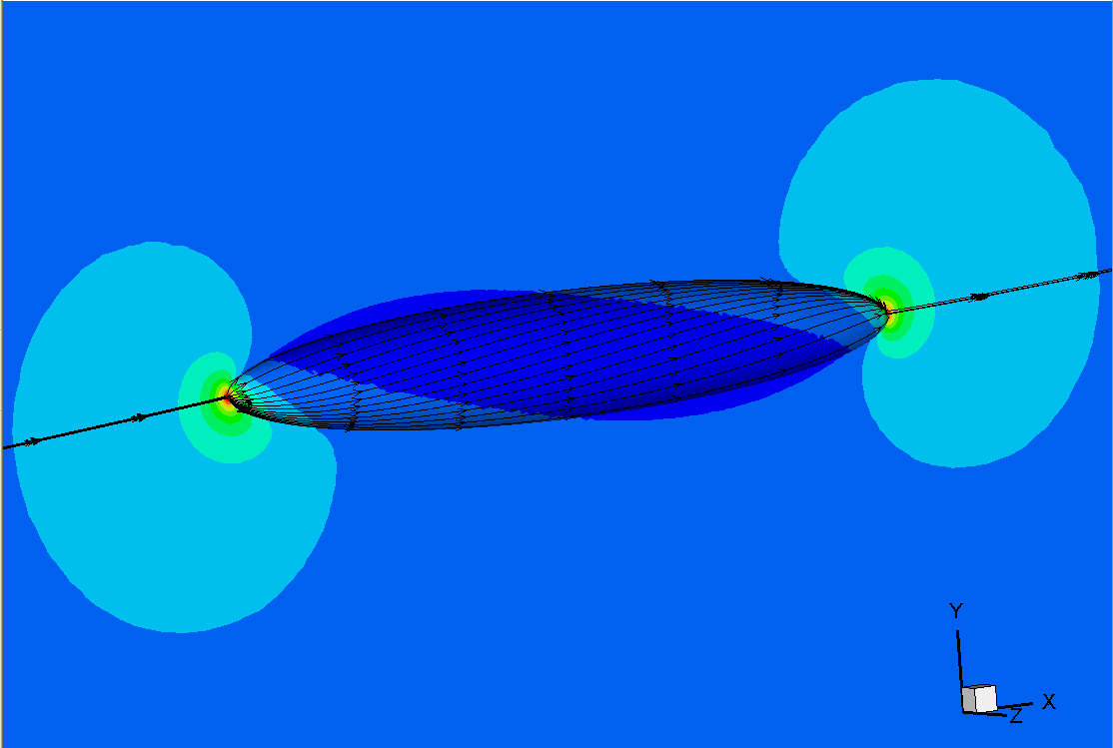
TEST CASE (3D)
SPHEROID Mach = 0.3, T = 281.53 K, P= 101325 Pa, Re =7.2x10^6
NEW IDEA → study along the streamlines
No crossflow → one-dimensional analysis

Slide 22
TEST CASE (3D)
SPHEROID Mach = 0.3, T = 281.53 K, P= 101325 Pa, Re =7.2x10^6
Results of the analisys along the streamlines:
For streamlines close to the symmetry plane → Problem → symmetry plane boundary condition
Far from the symmetry plane
→ Nolot ok
For N=7.2
→ Nolot not ok

Slide 23
TEST CASE (3D)
SPHEROID Mach = 0.3, T = 281.53 K, P= 101325 Pa, Re =7.2x10^6
Viscous calculation
AoA = 10°
→ no convergence (Fluent)
AoA = 5°
→ Fluent ok
AoA = 0°
→ Fluent not ok

Slide 24
CONCLUSIONS
Development of a new methodology for searching the transition locations on a wing profile.
Validation is successful for 2D profiles, as NACA0012.
For the NLF0416 profile we cannot be sure of the results since the literature provide us only the boundary layer separation.
Validation for the 3D geometries is more complicated for 3D effects.
Same methodology along the streamlines is ok but far from the symmetry plain.
For the moment Nolot code works only on simple geometries like a spheroid (axisymmetric).

Slide 25
FUTURE WORK
Manage the entire methodology to make it faster, efficient and reliable.
Make a study of the entire spheroid to see how much the symmetry plane influences the flow close to it.
Improving the Nolot code to use it along the streamlines allows to extend the methodology from 2D to 3D geometries.

Slide 26
THANKS FOR THE ATTENTION

